Slide 1
NELoRa
Towards Ultra-low SNR LoRa Communication with Neural-enhanced Demodulation
Chenning Li¹, Hanqing Guo¹, Shuai Tong², Xiao Zeng¹, Zhichao Cao¹, Mi Zhang¹, Qiben Yan¹, Li Xiao¹, Jiliang Wang², Yunhao Liu²
¹ Michigan State University ² Tsinghua University
November 15 @ ACM SenSys’21
1
Notes:
A neural-enhanced demodulation for lora communication

Slide 2
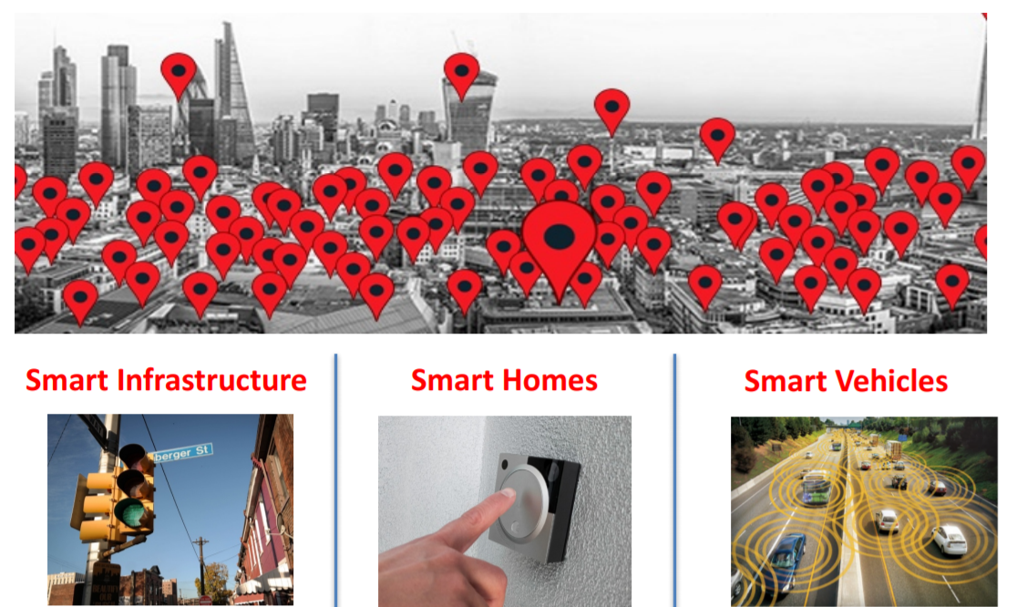

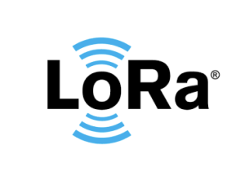
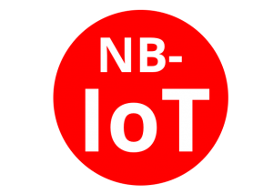
Low-power Wide-area Networks
Imaging a world where every single object is connected to the Internet
2
Notes:
Recent years have witnessed the emergence of Low-Power Wide- Area Networks (LPWANs) as a promising mechanism to connect billions of IoT devices. LoRa, SIGFOX, and NB-IoT are the three commercialized wireless technologies that facilitate the establishment of LPWANs.

Slide 3






















IoT Connectivity via LoRa
PHY Layer: Chirp Spread Spectrum (CSS) Modulation
IoT
Sensors
Gateway
$$+\frac{BW}{2}$$
$$f$$
$$Amplitude$$
Long Range
$$−\frac{BW}{2}$$
$$t$$
$$0$$
$$2^{SF}−1$$
$$FFT bin$$
Low Power
$$+\frac{BW}{2}$$
$$f$$
$$Amplitude$$
$$f_{0}$$
$$t$$
$$−\frac{BW}{2}$$
$$b_{0}$$
$$2^{SF}−1$$
$$0$$
$$FFT bin$$
3
Notes:
Among them, LoRa achieves the long-range and low-power communication between sensor nodes and gateways。
They key point is to modulate data using Chirp Spread Spectrum (CSS) in the physical Layer of LoRa.
From the sensor nodes to the LoRa gateway, CSS first defines a base up-chirp whose frequency increases linearly. Then it can encode data bits into the shifted initial frequency, as shown in the read line.
In this way, at the gateway side, it can adopt the Dechirp processing for decoding. And it first multiplies the chirp signal with the base down-chirp, the green line, and then applies the FFT on the dechirped signal. Therefore it can focus the chirp energy into the shifted frequency on the spectrum and decode the data bits by detecting the energy peak.

Slide 4
IoT Connectivity via LoRa
(a) SNR = 0
(b) SNR = -10
(c) SNR = -30
Long Range
Time (ms)
Time (ms)
Time (ms)
Overwhelmed Energy Peak
Low Power
Energy Peak Detection
Distorted Energy Peak
4
Notes:
In terms of the long-range and low-power communication, LoRa can suppress the energy of noise by focusing the spectral energy on the spectrum, which allows sensor nodes to send data to gateways several or even tens of miles away.
However, as the SNR gets lower and lower, the energy peak can be distorted or even overwhelmed by the noise energy, resulting the decoding failure.

Slide 5
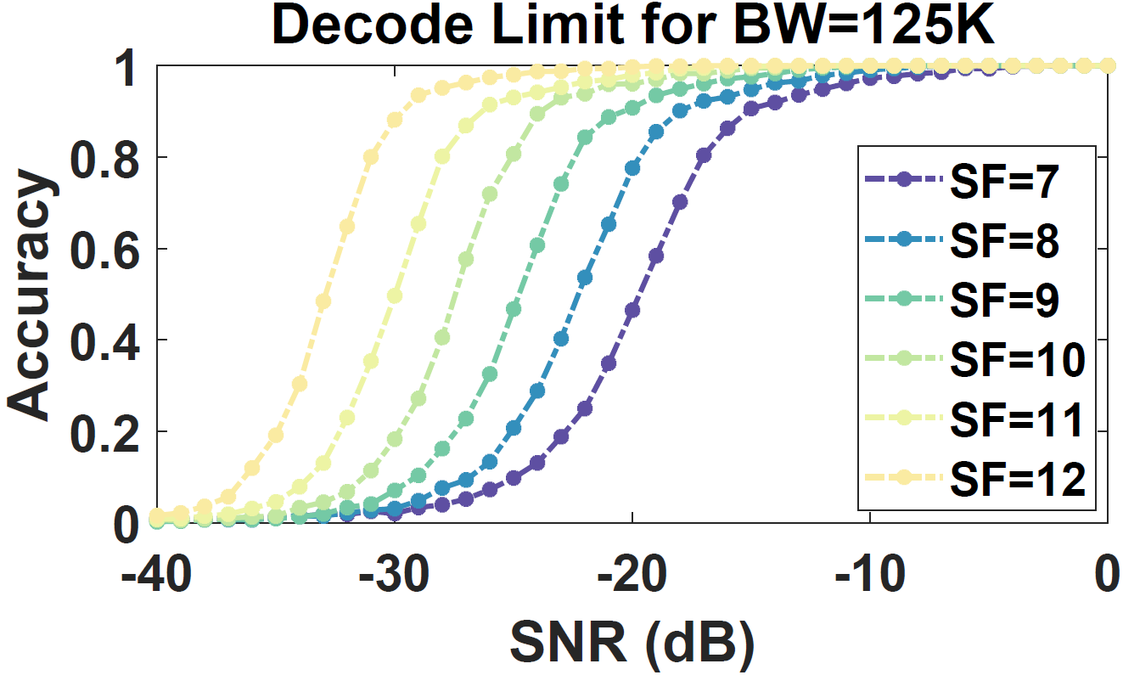
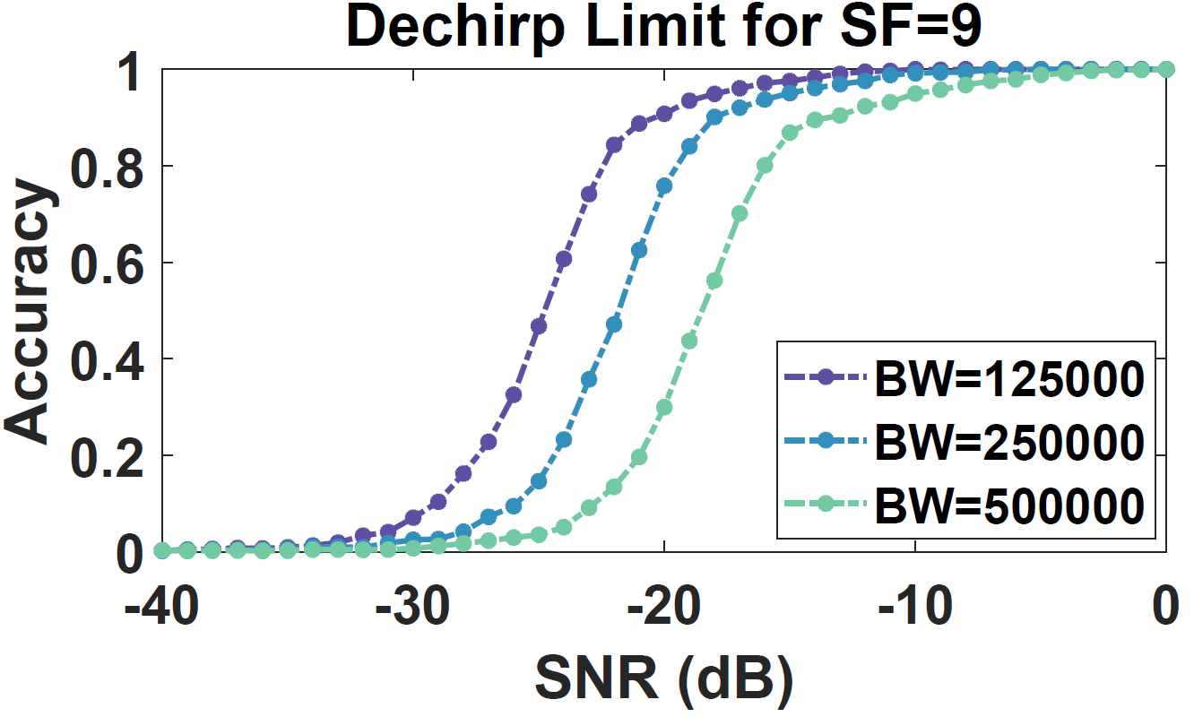
IoT Connectivity via LoRa
IoT
Sensors
Gateway
Weak Signal Decoding
SNR Threshold of the standard Dechirp processing
Communication Range & Battey Life
5
Notes:
From the sensor nodes to the LoRa gateway, we plot the chirp symbol decoding accuracy with different SNR conditions, under different configurations of LoRa, including SF and BW.
As we can see, the standard LoRa demodulation method, dechirp, determines an SNR threshold under which chirp symbols cannot be decoded reliably.
Generally, a larger SF enables a lower SNR threshold, which results in a longer communication range and larger energy consumption under the same BW.
Given the relationship between the SNR threshold and the communication range, the weak signal decoding has been a hot research topic in our fields.

Slide 6
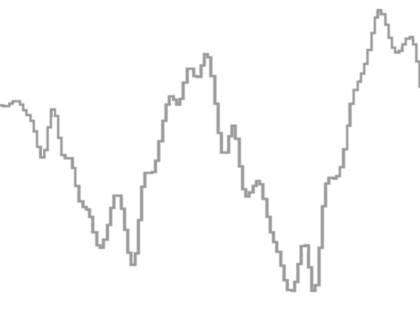
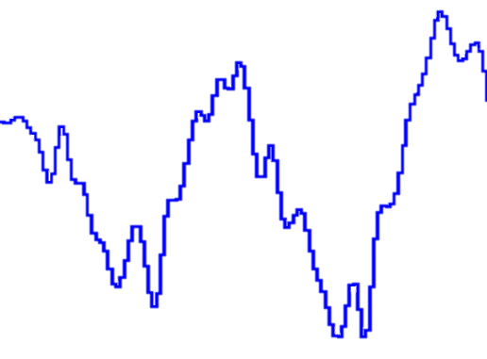
SoTAs: Weak Signal Decoding
Observed SNR:
SNR Threshold:
SoTAs
Multiple LoRa Nodes / Gateways
SNR
SNR Gains
Gateway
Temporal SNR of a LoRa link
Time
6
Notes:
For example, given the observed SNR of chirp signals and the threshold of the Dechirp processing, to avoid the Dechirp failure, most existing works aim to improve the SNR of observed signals over a weak LoRa link, as the blue curve depicted in this figure.
Such SNR gains are obtained by leveraging information collected from multiple LoRa nodes or gateways. Although these approaches have achieved impressive SNR gains, such gains are obtained costly if the LoRa nodes and gateways are not densely deployed.

Slide 7
SoTAs: Multi-pair Transceivers
IoT Sensors
Gateway
SNR
Gains
Observed SNR:
SNR Threshold:
SoTAs
Choir
SIGCOMM’17
1
36
N/A
SNR
Charm
IPSN ’18
1-3dB
2-8
SNR Gains
1
Gateway
OPR
MobiSys ’20
1.5-2.5dB
2-6
1
Temporal SNR of a LoRa link
Time
Chime
NSDI ’20
4-6
1
2.4-3.4dB
7
Notes:
For instance, Choir leverages up to 36 co-located LoRa nodes to boost the received signal strength; Charm utilizes the spatial diversity of 2 to 8 gateways to decode weak chirp symbols through the coherently decoding processing.

Slide 8

Problem: Weak Signal Decoding
Observed SNR:
SNR Threshold:
SoTAs
SNR
SNR Gains
Gateway
SNR Gains
Temporal SNR of a LoRa link
Time
8
Notes:
All existing solutions inspires us to think about this question, can we optimize the weak signal decoding by decreasing the SNR threshold directly?

Slide 9
Motivation: Weak Signal Decoding
Observed SNR:
SNR Threshold:
SoTAs
NELoRa: neural-enhanced Demodulator
Neural-enhanced Decoder
Extra SNR Gains
Single Pair of LoRa Transceiver
Orthogonal to existing works
SNR
SNR Gains
Gateway
SNR Gains
Temporal SNR of a LoRa link
Time
System Design
Observations
Challenges
9
Notes:
This motivates our work, NELoRa, a data-driven neural-enhanced demodulator.
It aims to capture extra SNR gains by decreasing the SNR threshold of the Dechirp directly.
Besides, it only relies on the single pair of LoRa transceiver and is orthogonal to all existing works.

Slide 10
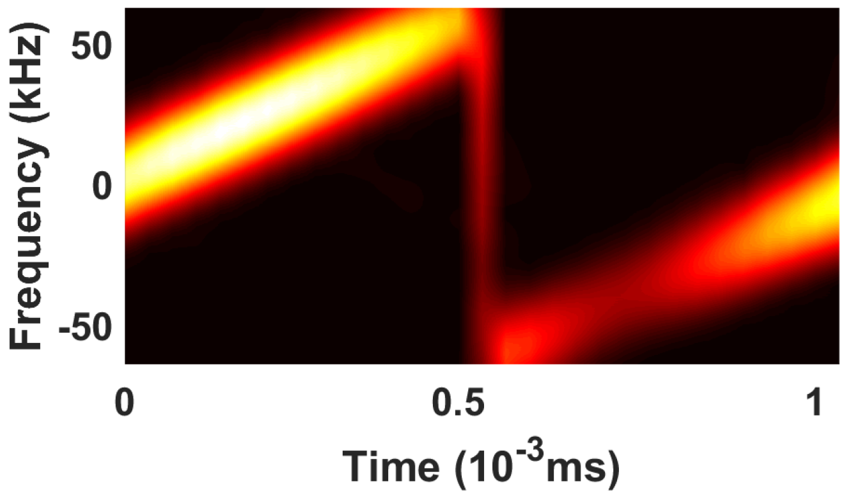
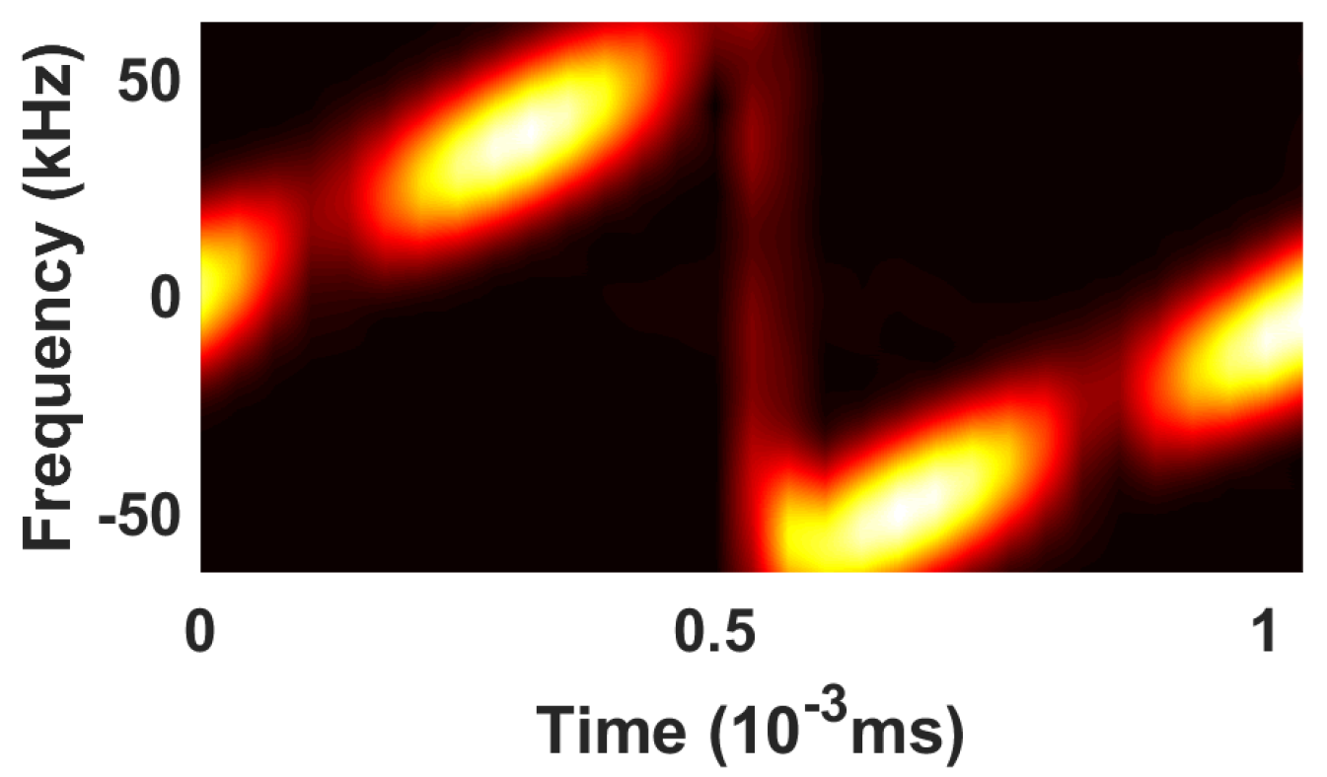
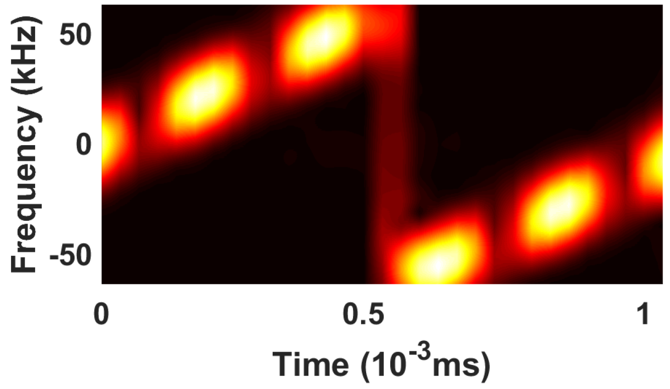
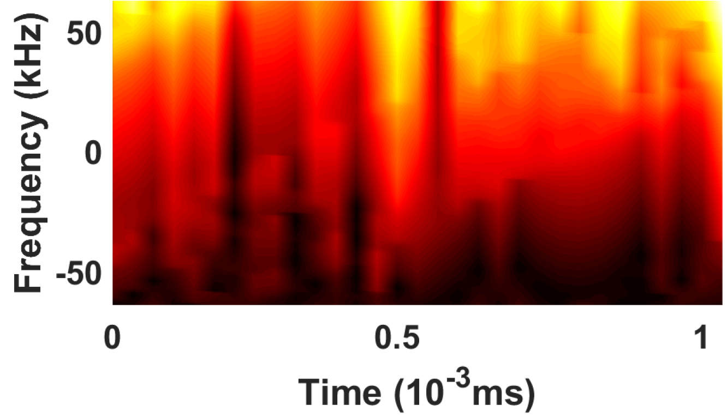
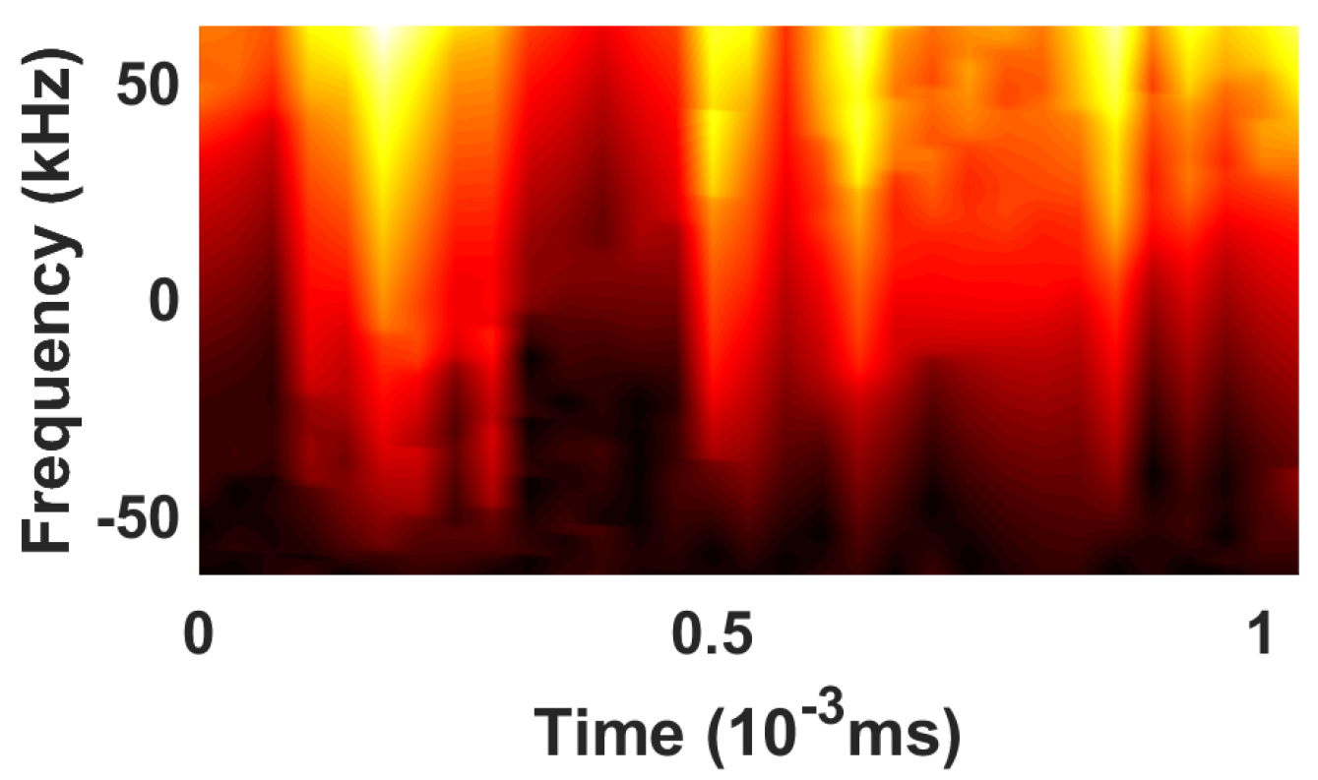
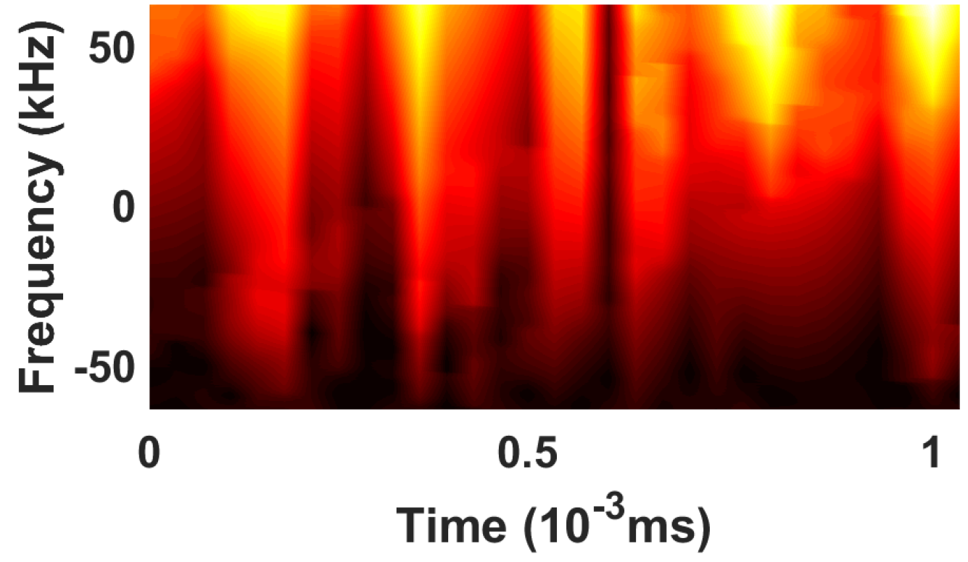
Observation-1: Unique Pattern
Amplitude
Phase
Time (ms)
Time (ms)
Time (ms)
(a) “0x41” - “0x40”
(b) “0x43” - “0x40”
(c) “0x45” - “0x40”
Takeaway-1: the spectrogram pattern makes it a unique feature
10
Notes:
The idea of applying deep learning stems from our three observations.
First, the chirp itself. As a neural-enhanced decoder, NELoRa takes as input the 2-dimensional spectrogram of chirp symbols, including its amplitude and phase information.
Shown in this figure, we first collect four SF7 chirp symbols. They represent four different but very close data bits.
To illustrate their signal difference more clearly, we plot their spectrogram on the difference of amplitude and phase.
Although the encoded initial frequencies among the four chirps are close, we can clearly observe the unique energy peak distributions from the difference spectrogram. Additionally, we can see peaks (e.g., bright areas) and valleys (e.g., dark areas) alternatively appear in both amplitude and phase spectrograms. Specifically, the patterns observed by amplitude and phase are correlated, but different chirp symbols exhibit diverse patterns. Hence, such a spectrogram pattern is a unique feature dimension to distinguish different chirp symbols.

Slide 11
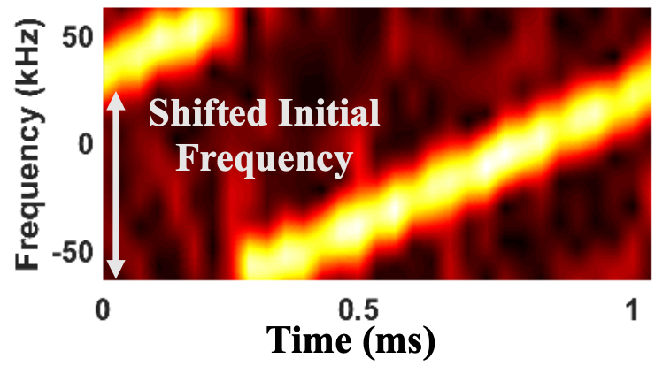
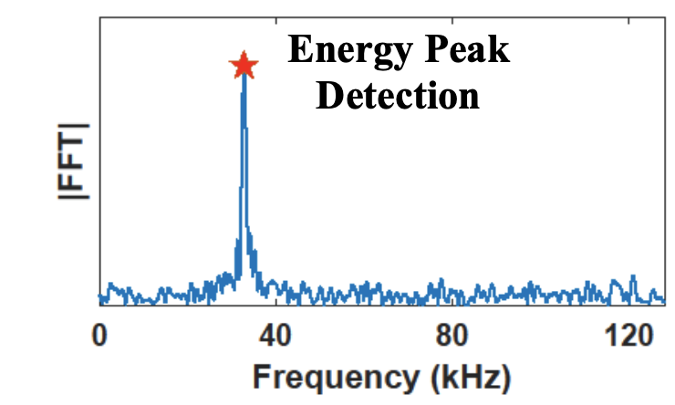
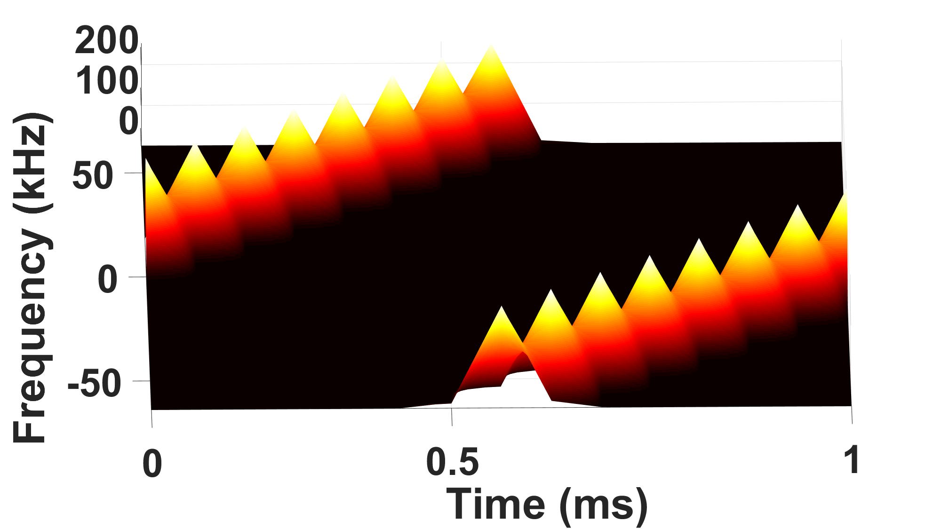
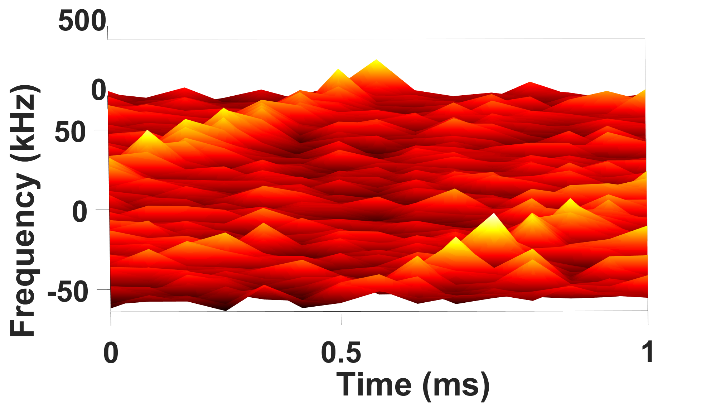
Observation-2: 2D Robust Pattern
Standard Dechirp
vs.
Neural-enhanced Decoder
Takeaway-2: NELoRa can still recognize it even with partial energy peaks
11
Notes:
The second observation is about the robustness of our 2D spectrogram.
As we know, in the standard Dechirp processing, it detects the 1-dimensional energy peak on the spectrum.
However, NELoRa takes as input the 2-d spectrogram, which is noise-resilient. Specifically, the energy peak distribution on the amplitude spectrogram exhibits a linear pattern. And even facing severe polluted noises, we can still observe parts of energy peaks, which can be potentially learned and recognized by our neural-enhanced decoder.

Slide 12
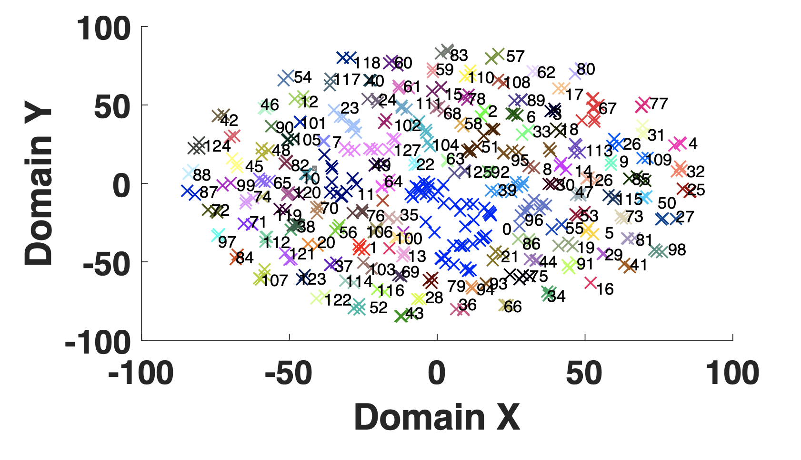
Observation-3: Finite Feature Space
(a) Across Period
SF=7: 128 Different Codes
(b) Across Node
(c) Across Environment
Takeaway-3: the finite coding space of LoRa for data-driven NELoRa
12
Notes:
The third observations is the finite feature space of LoRa chirp symbols. Since we know LoRa can only encode a fixed size of data bits under certain configurations. For example, for SF=7, it is 2^7=128 codes.
Thus, such a finite feature space can fully exploit the learning ability DNN. Moreover, the finite feature space is robust across different environments. For example, given chirps from different periods, nodes and environments, our trained DNN can always recognize the encoded chirp spectrogram due to its fixed pattern corresponding to. Its encoded data.

Slide 13
System Design
Raw Signals
Packet
Identification
DNN Input Generation
DNN-based Demodulation
1 Packet
Radio
Front End
Mask-enabled
Filter
LoRa
Packet
Chirp
Enhance
Offset Recovery
PHY Samples
LoRa Symbols
Preamble
Detection
Symbol
Transform
Spec-based
Decoder
Symbol Generation
Neural-enhanced Demodulation
13
Notes:
Given our three observations, we design the system framework of NELoRa by incorporating the chirp knowledge and deep learning.
Upon receiving the raw signal from the sensor nodes, NELoRa first adopts signal processing for chirp symbol generation, including packet identification and offset recovery.
Then it feeds the offset-free chirp symbols into our Neural-enhanced Demodulation, covering the spectrogram generation and DNN-based demodulation.
Finally, it outputs the decoded data bits for each LoRa packets.

Slide 14
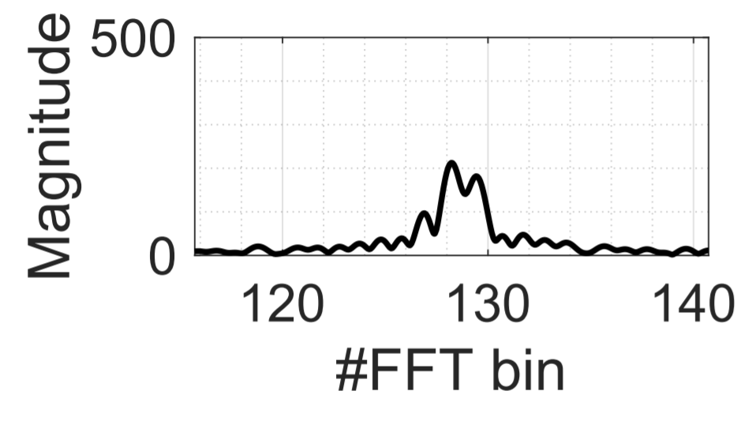
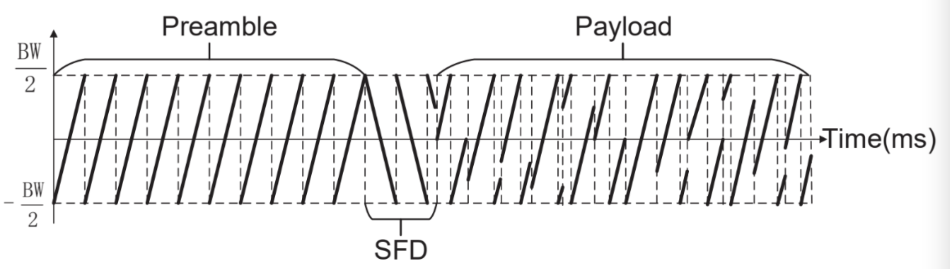
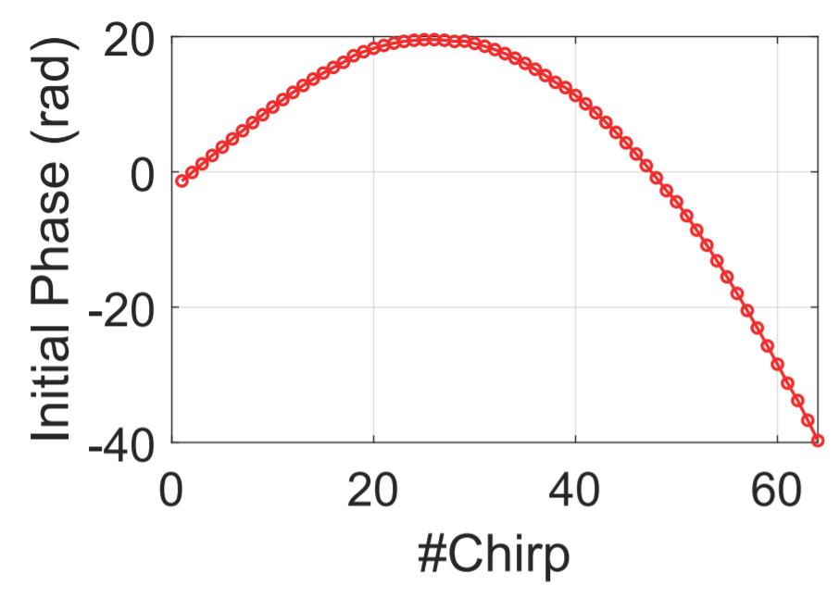
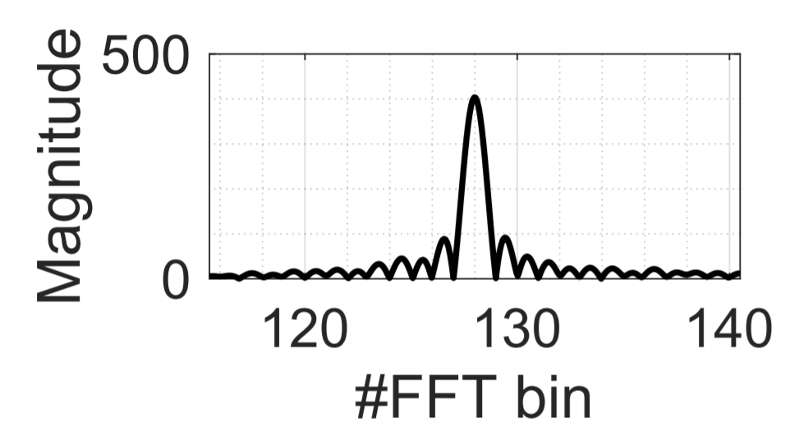
Challenge-1: Symbol Generation
Add up destructively
Add up constructively
14
Notes:
Before we do the chirp symbol demodulation, the first challenge is how to get the chirp symbols.
Given the preamble of a LoRa packet, say 8 base upchirps in a row, we propose to accumulate the energy of all eight base upchirps on the spectrum thus it can detect the packet under extremely low SNR conditions, which cannot become the bottleneck of our following DNN demodulations.
However, accumulating the 8 base upchirps is non-trivial due to the random initial phase of each base upchirp, resulting in the destructive accumulation on the spectrum.
To achieve the constructive accumulation of those base upchirps, we design a phase searching algorithm for accurately compensating the phase offsets over multiple base upchirps. It cannot only detect the preambles reliably but also compute the offset of the whole packet accurately. After this, we can divide the whole packets into a series of offset-free symbols.

Slide 15
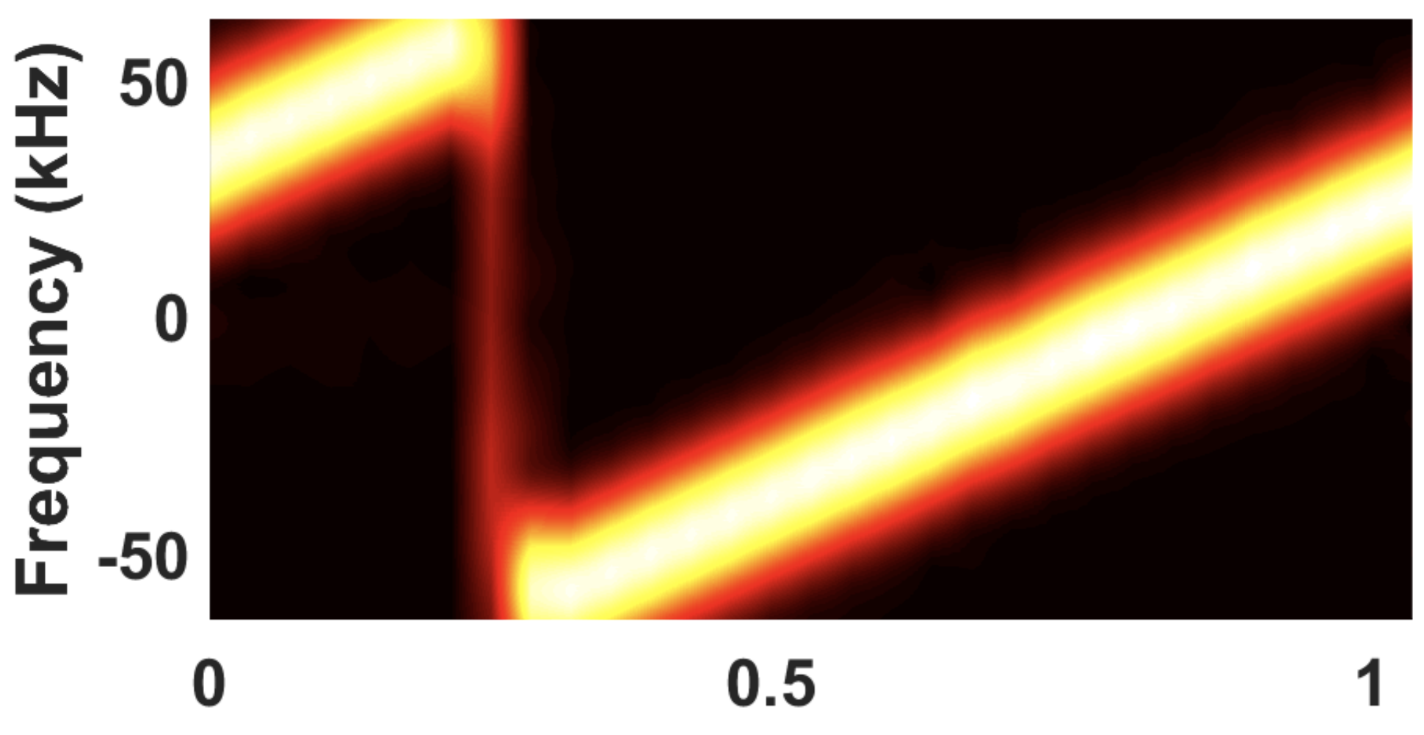
Challenge-2: Noise & Interference
(a) GT Spectrogram
(b) Raw Spectrogram
(c) Masked Spectrogram
Signal Processing
Filter
SPWVD Mask
vs.
Neural-enhanced Filter
Time (ms)
Time (ms)
Time (ms)
DNN Mask
Time (ms)
Time (ms)
Time (ms)
15
Notes:
The second challenge is to deal with the severe noise under low SNR conditions. Since you cannot expect the DNN to recognize the spectrogram pattern directly.
At the beginning, we tried the signal-processing based filter for noise reduction. It aims to extract the primary components of the chirp signals. However, it can only remove noise under a relatively higher SNR, around -10--15dB.
In contrast, we design a mask-based DNN filter, which is a data-driven filter and can derive the clean chirp symbols even under low SNRs such as -20dB.

Slide 16
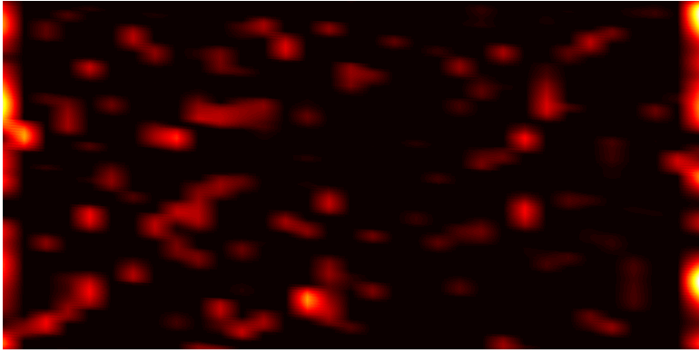
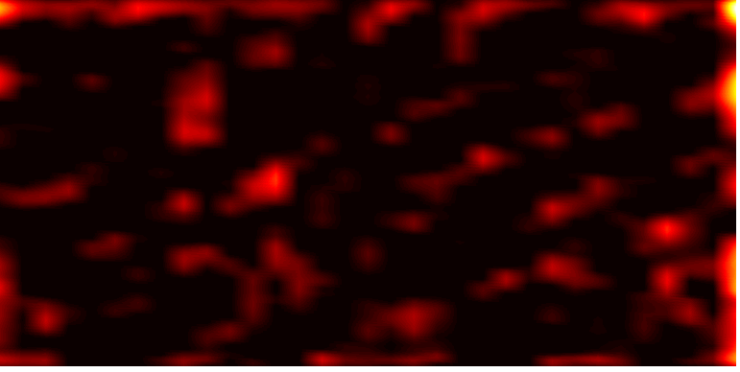
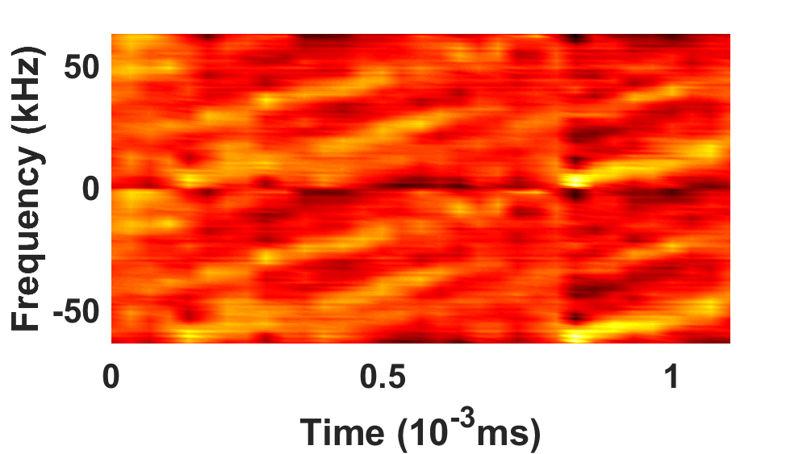
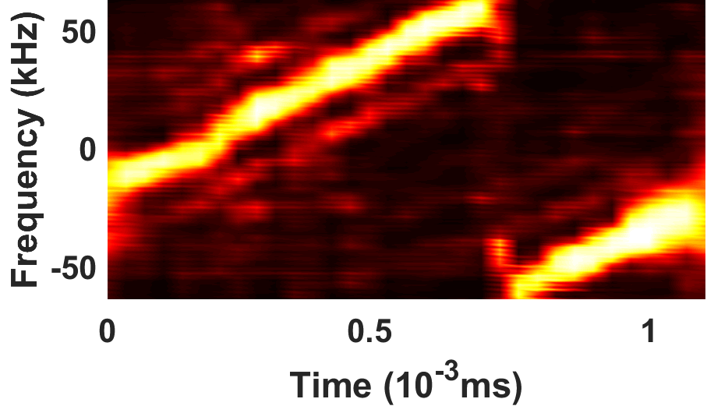
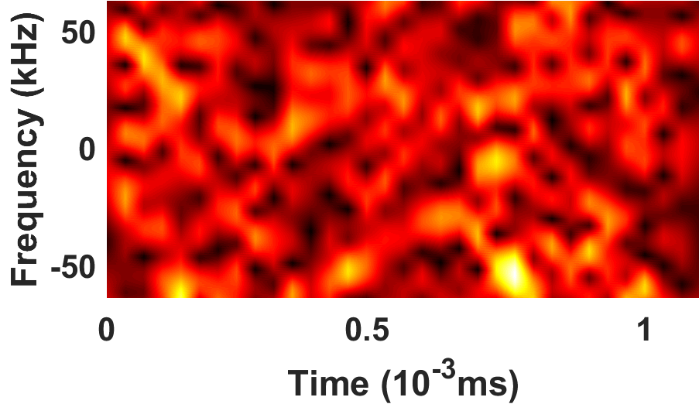
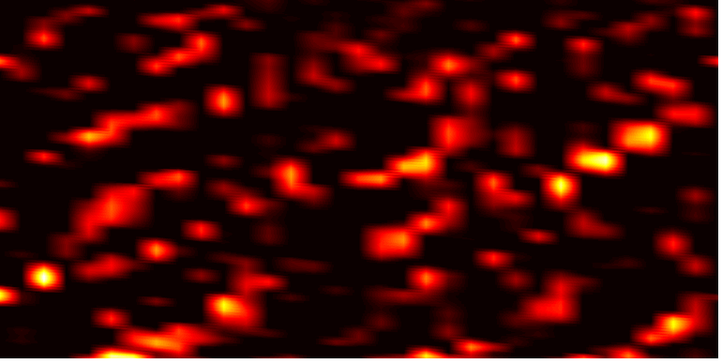
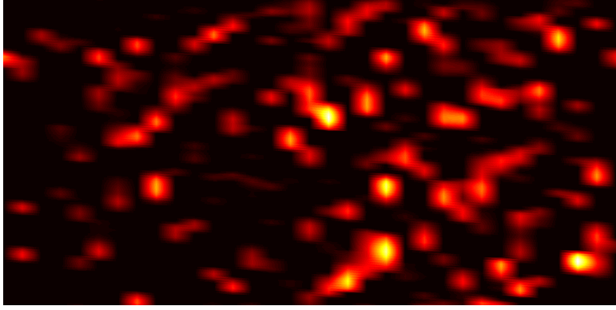
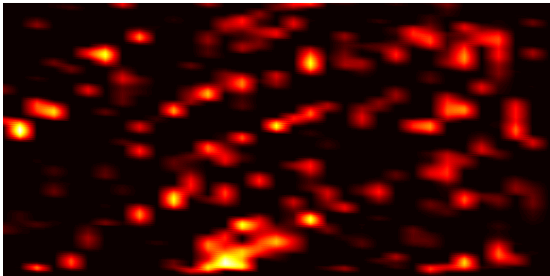
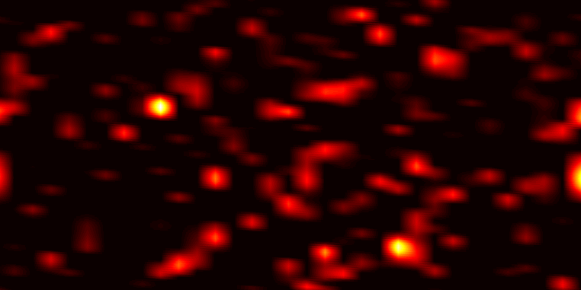
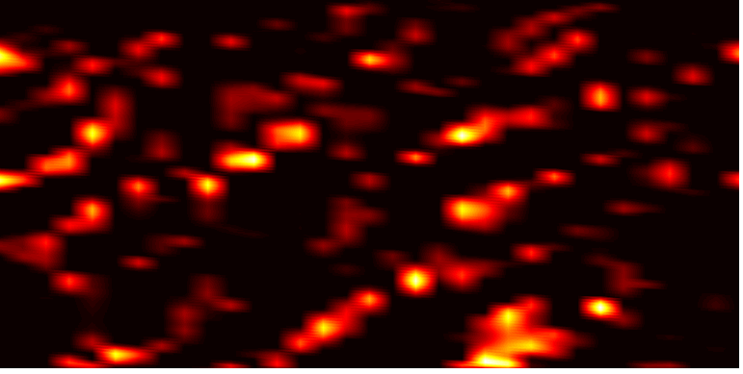
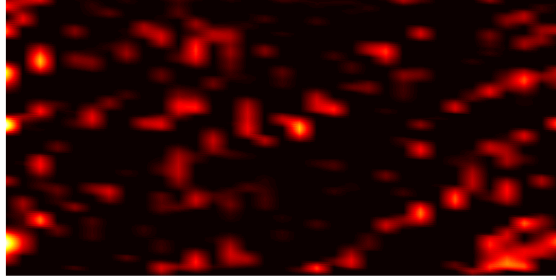
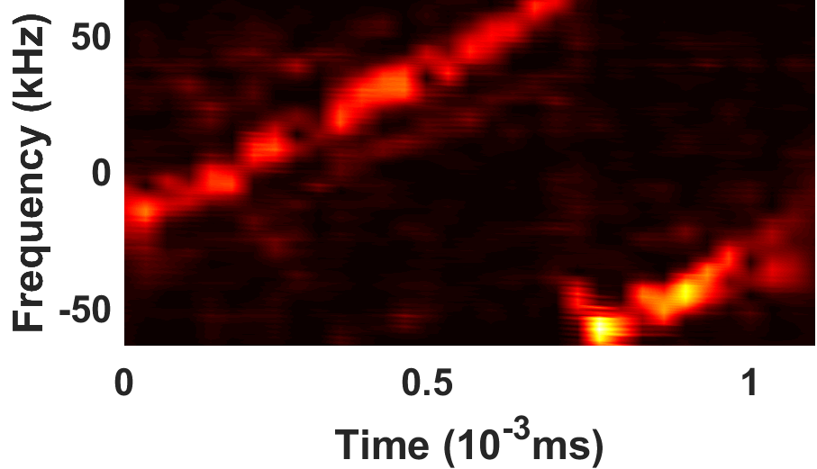
Challenge-3: Network Design
Mask-enabled DNN Filter
Masked Spectrogram
Decoded
Data
Dense
ReLU
ZeroPad
ReLu
Blks
…
SoftMax
Dropout
Dense
Conv2d
Pooling
Dual-channel Spectrogram
*
ZeroPad
ReLU
ReLU
Sigmoid
Conv2d
ReLU
LSTM
Dense
Dense
BatchNorm
GT Spectrogram
GT Data
Mask
Operation
Spectrogram-based DNN Decoder
Distorted Energy Peak Distribution
Time (ms)
(c) LSTM & Dense1
(d) Dense2 / Mask
Time (ms)
(a) Input Spec.
(b) 8-channel Output from 8-block CNN
*
Time (ms)
(e) Masked Spec.
16
Notes:
The last challenge is the whole DNN design of our neural-enhanced demodulation.
Given the raw spectrogram with amplitude and phase information, we show our deep neural network design with the intermediate results. As mentioned before, the first part is a mask-based DNN filter. As we can see, although the input spectrogram is noisy and cannot be distinguished by human eyes, our DNN network can gradually recognizes the linearly increasing pattern for chirp spectrogram. It outputs a mask and we need to multiply it with the raw spectrogram to reduce the noise.
Upon receiving the clean chirp spectrogram, we design another spectrogram-based DNN decoder, which can exploit the finite coding space of LoRa symbols and output the correct decoded data bits.

Slide 17
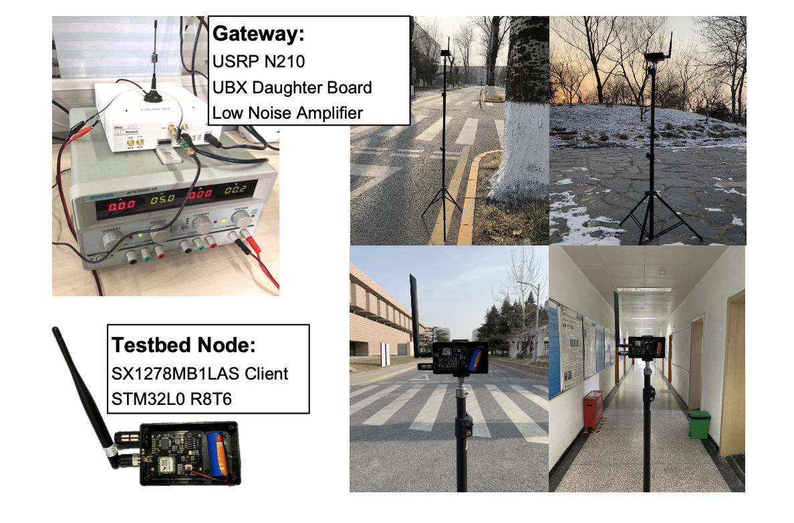
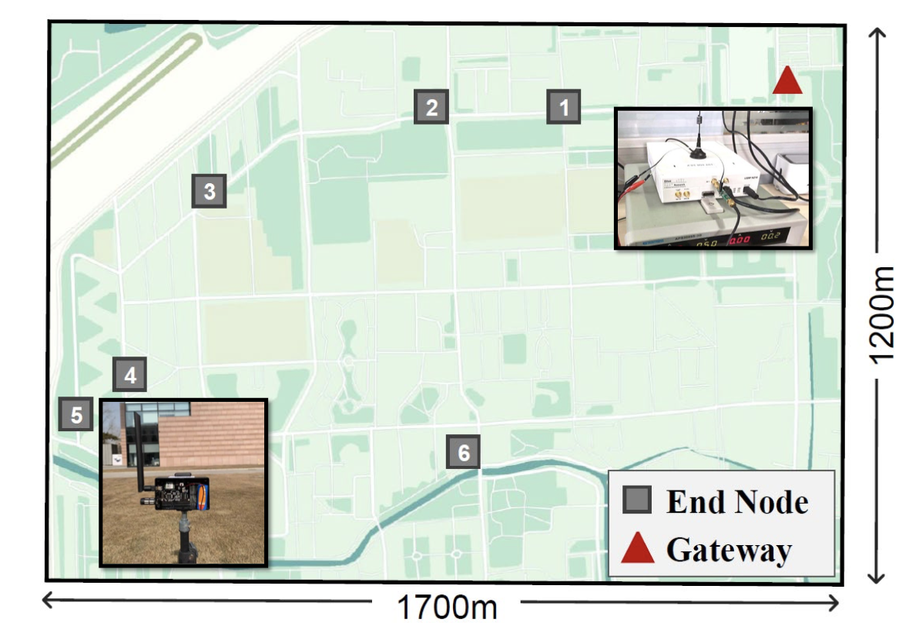
Implementation
Metric:
  Symbol Error Rate (SER)
  SNR Gains (SER=10%)
  Battery Life Gain (BLG)
Baseline:
  Standard Dechirp Processing
17
Notes:
We start our implementation and evaluation from this page, including the indoor platform in the building and an outdoor experiment at the campus.
We adopt the commercial LoRa sensor nodes since there is no modification on the sensor side and we use USRP as the gateway.
In terms of evaluation metrics, we care about the symbol error rate of LoRa under different SNR conditions, the SNR gains for SNR threshold when the SER equals to 10%, and the corresponding battery life gains.
All these gains are computed based on our baseline, the standard Dechirp processing.

Slide 18
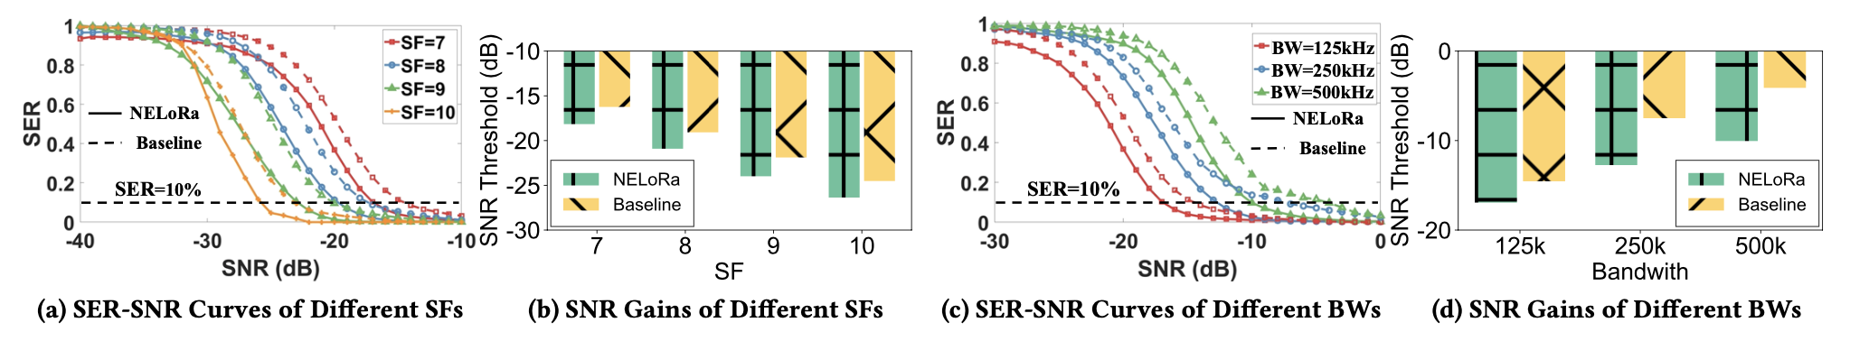
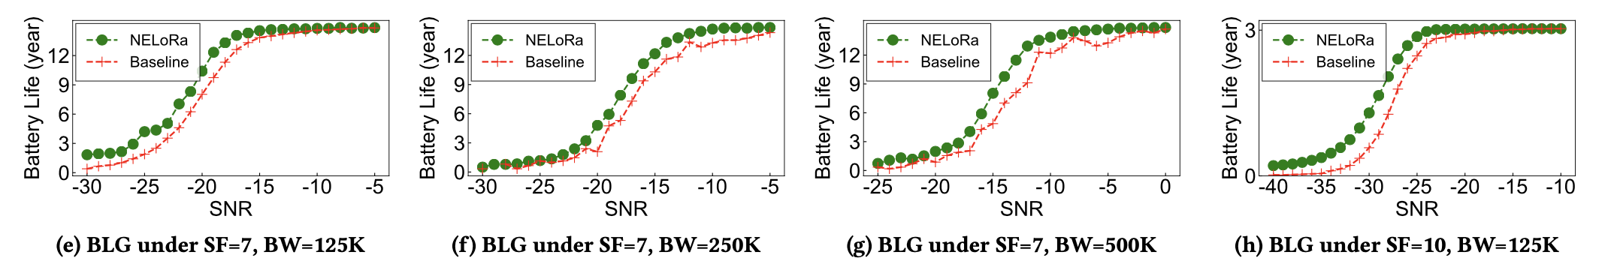
Evaluation： Indoor Performance
  Q1 - How much does NELoRa improve the demodulation performance than Dechirp under various LoRa configurations?
18
Notes:
The first question, How much does NELoRa improve the demodulation performance than dechirp under various LoRa configurations?
We first show the SER and corresponding SNR gains in this page. As you can see, NELoRa outperforms the baseline for all testing configurations. For different SFs, the SNR gain is ranging from 1.84 dB to 2.35 dB. Besides, the SNR threshold of NELoRa at an SF can almost catch up with dechirp at a higher SF. For example, the SNR threshold of NELoRa at SF=7 is close to dechirp’s at SF=8.
We further evaluate the battery life for NELoRa and the baseline, we can see all the green lines for NELoRa are higher than the red ones, resulting a consistent BLG for different SNR levels and LoRa configurations

Slide 19
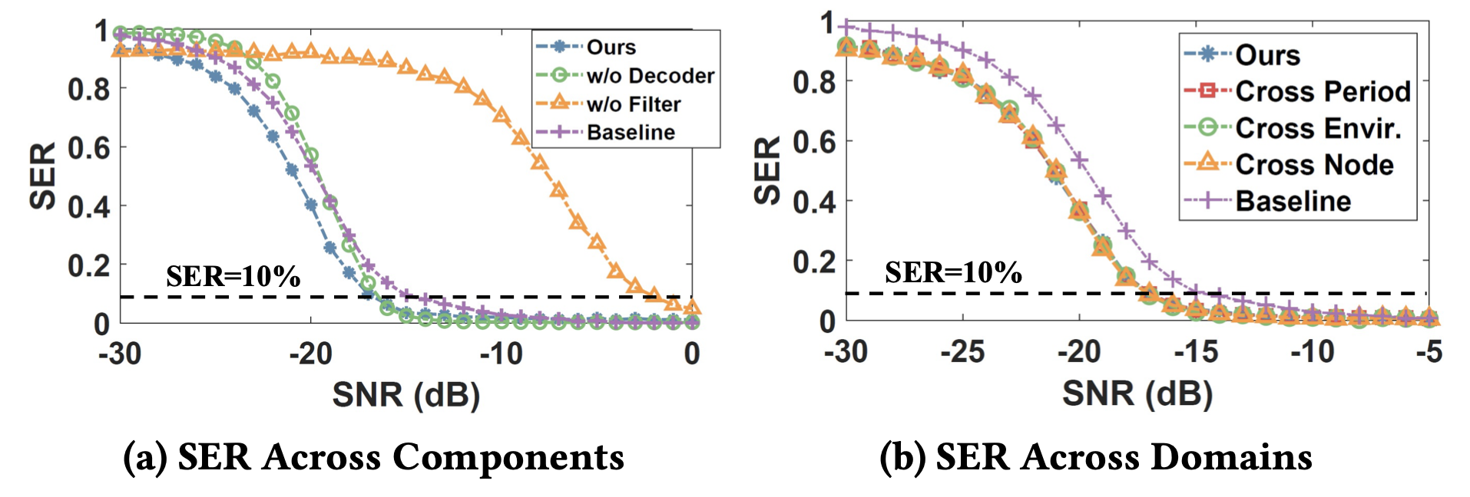

Evaluation： Robustness Analysis
  Q2 - How effective is each key technique incorporated in the design of NELoRa?
  Q3 - Is NELoRa robust to different environments for low-cost deployment?
19
Notes:
Next, we answer these two questions. How effective is each key technique incorporated in the design of NELoRa? Shown in this figure, NELoRa suffers by removing the mask-based filter or spectrogram-based decoder. An interesting thing is that we cannot incorporate DNN filter with the Dechirp, which underperforms in comparison with our DNN decoder.
Further, we evaluate the robustness of NELoRa, in which we apply our trained DNN model on new data from different periods, nodes and environments directly, without model retraining. This SER-SNR figure shows that NELoRa outperforms the baseline consistently due to the finite feature space of LoRa chirp symsbols.

Slide 20
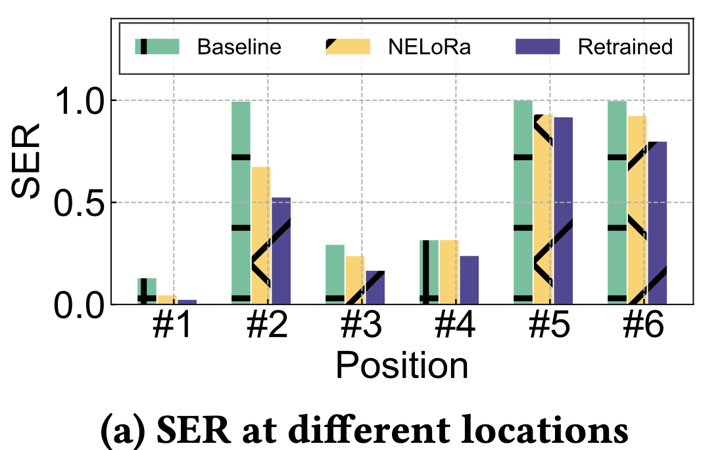
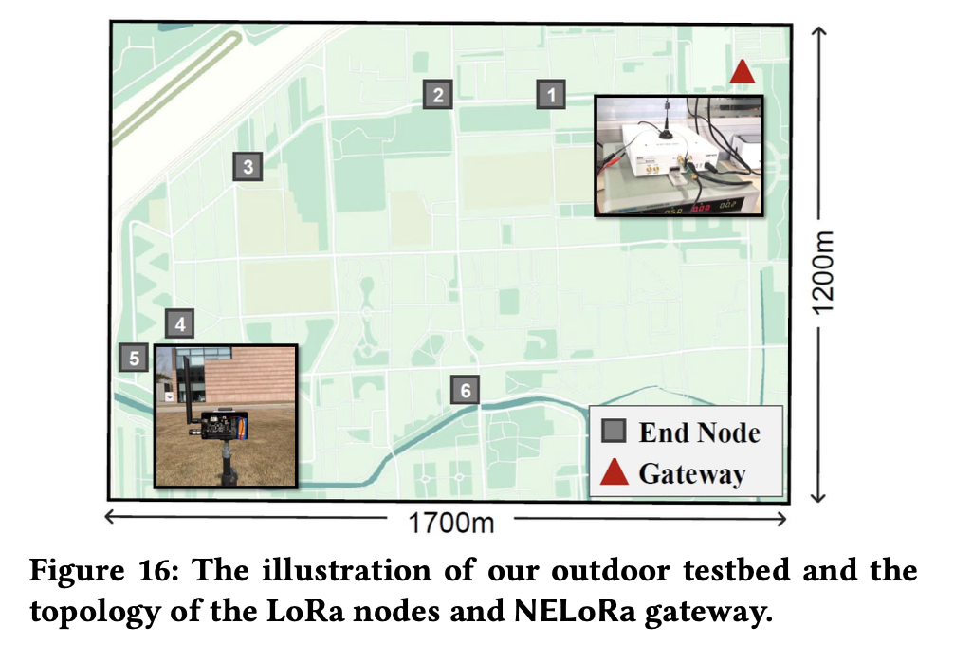
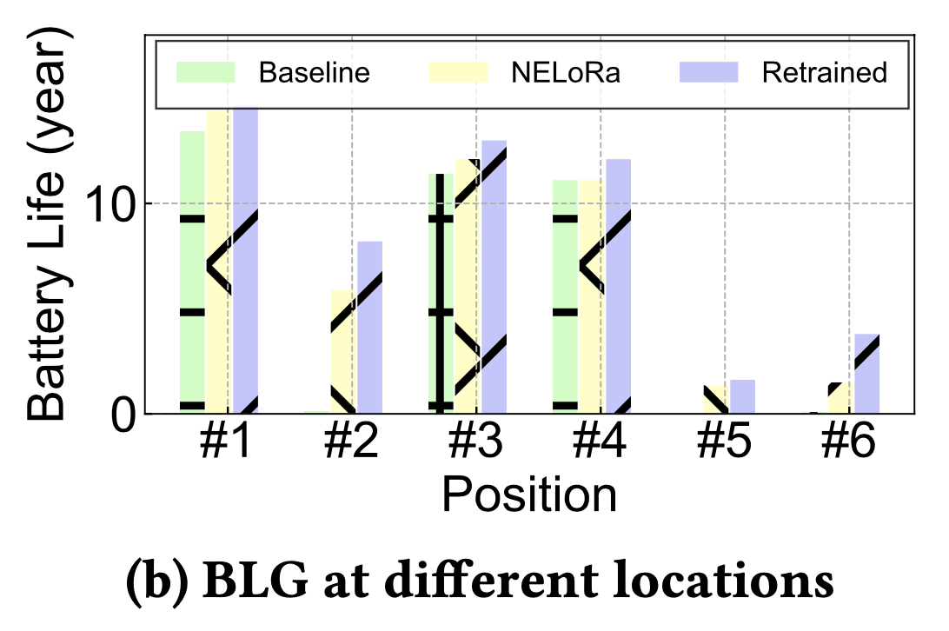
Evaluation： Outdoor Performance
  Q4. What is the performance of NELoRa in outdoor environment?
20
Notes:
The last question is about the outdoor performance of NELoRa. We first collect the LoRa packets from 6 positions at the campus and run our end-to-end system from the packet detection to the decoded data bits.
As we can see, compared with the baseline, the original NELoRa decreases SER of the Dechirp for all six positions
Besides, we also re-trained our DNN model, which achieves a little better performance than the original one by capturing more unseen noise patterns. This demonstrates that we can further improve NELoRa by updating in an online and distributed manner as more packets are collected across multiple gateways.

Slide 21
Conclusions
To the best of our knowledge, NELoRa represents the first neural-enhanced LoRa demodulation method with the minimum deployment cost.
SNR Threshold of
Demodulation
Communication Range
&
Battey Lifetime
The datasets and source codes are available at https://github.com/hanqingguo/NELoRa-Sensys
21
Notes:
In this paper, we present the design, implementation, and evaluation of NELoRa, a neural-enhanced LoRa demodulation system that breaks the SNR threshold of the standard dechirp approach. The SNR gains enable longer communication distance and battery lifetime in LoRa.
Of course, NELoRa has some limitations as the future work.
First, the maximum SF we evaluated is 10 and a commodity LoRa node can support two larger SFs, namely 11 and 12. With the increasing SF, the chirp symbol length and types exponentially increase. As a result, we must use much more computation to train the DNN model. According to the consistent SNR gains observed when SF increases from 7 to 10, similar SNR gains can be expected when SF is 11 or 12 as long as the DNN model is trainable. we have to optimize the structure of our DNN model to reduce its model complexity and converge time.
Second, currently, NELoRa takes as input the spectrogram of chirp symbols and is incorporated with our packet detection algorithms. However, existing works, such as deepsense, has verified the feasibility of deep learning on carrier sense for efficient channel access. Thus, we expect a holistic neural-enhanced demodulation method in the further.
Third, given widely deployed LoRa nodes, gateways and massive collected data, a promising optimization is to update NELoRa in an online manner, such as the federated learning.

