Slide 1
Wi-Fi See It All: Generative Adversarial network-augmented Versatile Wi-Fi Imaging
Chenning Li¹, Zheng Liu¹, Yuguang Yao¹, Zhichao Cao¹, Mi Zhang¹, Yunhao Liu^{1,2}
¹ Michigan State University ² Tsinghua University
November 18 @ ACM SenSys’20
1

Slide 2
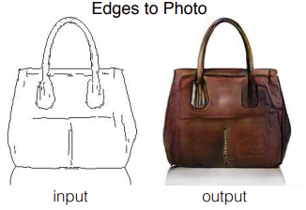
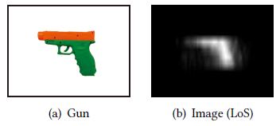
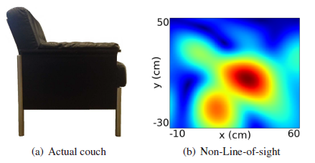
Motivation: Wi-Fi Imaging
Computer Vision Acoustics Wi-Fi
Pix2pix CVPR’17 AIM MobiSys ‘18 Wision SenSys’14
Wi-Fi VS. Others:
Less privacy concern
Large surveillance area
More ubiquitous deployment
Wi-Fi Imaging has more potentials to be explored !
2
Notes:
We human beings always want to talk, especially during the quarantine. And Interacting with machines is an interesting thing for social distancing. For example, gesture recognition
It sparks an easy way to interact with the machines, the gesture recognition, which is the core enabler for a wide range of applications, such as the smart home, the VR, and security surveillance.
Actually, such a scenario has been already dictated in 1983. A famous science fiction, the robots of Dawn, written by Isaac Asimov.
As it mentions, the introduced distortions on the electromagnetic waves by the arm motion can be sensed by the machines.
However, What if the machine doesn’t know who he serves for? That means he cares for your home and serves for anyone that performs the predefined gestures.

Slide 3
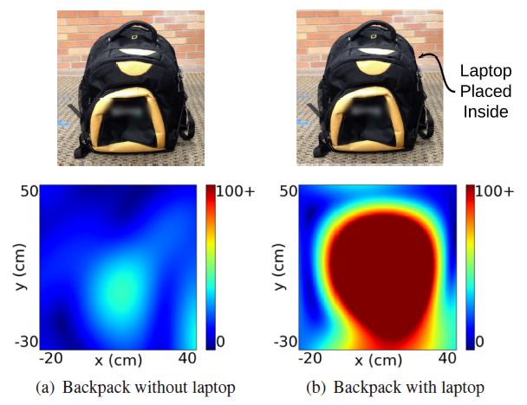
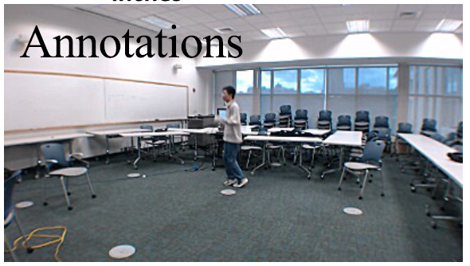
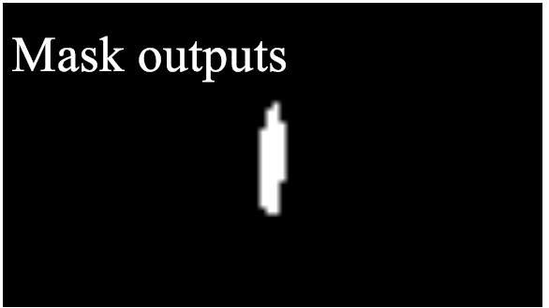
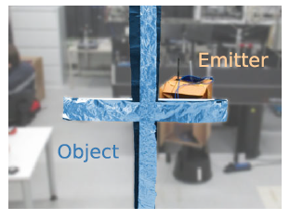
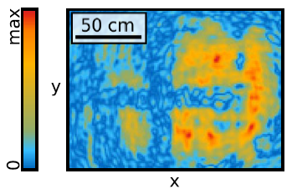
Existing Wi-Fi Imaging
Wision SenSys ’17 F. Wang ICCV’19
P. Holl PRL ’17 WiPose MobiCom’20
3
Notes:
We human beings always want to talk, especially during the quarantine. And Interacting with machines is an interesting thing for social distancing. For example, gesture recognition
It sparks an easy way to interact with the machines, the gesture recognition, which is the core enabler for a wide range of applications, such as the smart home, the VR, and security surveillance.
Actually, such a scenario has been already dictated in 1983. A famous science fiction, the robots of Dawn, written by Isaac Asimov.
As it mentions, the introduced distortions on the electromagnetic waves by the arm motion can be sensed by the machines.
However, What if the machine doesn’t know who he serves for? That means he cares for your home and serves for anyone that performs the predefined gestures.

Slide 4
Existing Wi-Fi Imaging
Limitations to be improved:
Specially designed Device:
Wision SenSys’14, P. Proffitt HST’18, RF_Avatar ICCV’19
Coarse-grained Profiling:
C. Karanam IPSN’17, P. Holl PRL’17, C. Wang CNS’18
Application-specific imaging for only humans
WiPose Mobicom’20, F. Wang ICCV’19, RF_Pose3D SIGCOMM’18
Note: refer to the Table 1 in paper for more details.
We aim to achieve fine-grained Wi-Fi imaging for multiple objects via COTS Wi-Fi.
4
Notes:
Generally, it’s always a hot topic to identify users.
For example,, inspired by the CV, which proves the gait can be utilized as a biometry feature. Some researches verify the feasibility of user identification with gait while maximizing the advantages of the wireless signals, such as through the wall and no requirements for the light conditions.
Besides, the location-oriented activities can also be used for user identification. However, both cannot convey the extra semantic meaning like diverse gestures.
Of course, someone tried to do the user identified gesture recognition, like WiID publish in UbiComp ’18, However, it has two drawbacks:
First it only functions with the WiFi based gesture recognition system as an add-on module and requires the known gesture information.
Moreover, it suffers when we leverages it in a new domains, including the location, orientation and environments, due to the variance of the domains.
To the best of our knowledge, none of the existing works can do the user identified gesture recognition in real time while considering the cross-domain scenarios.

Slide 5
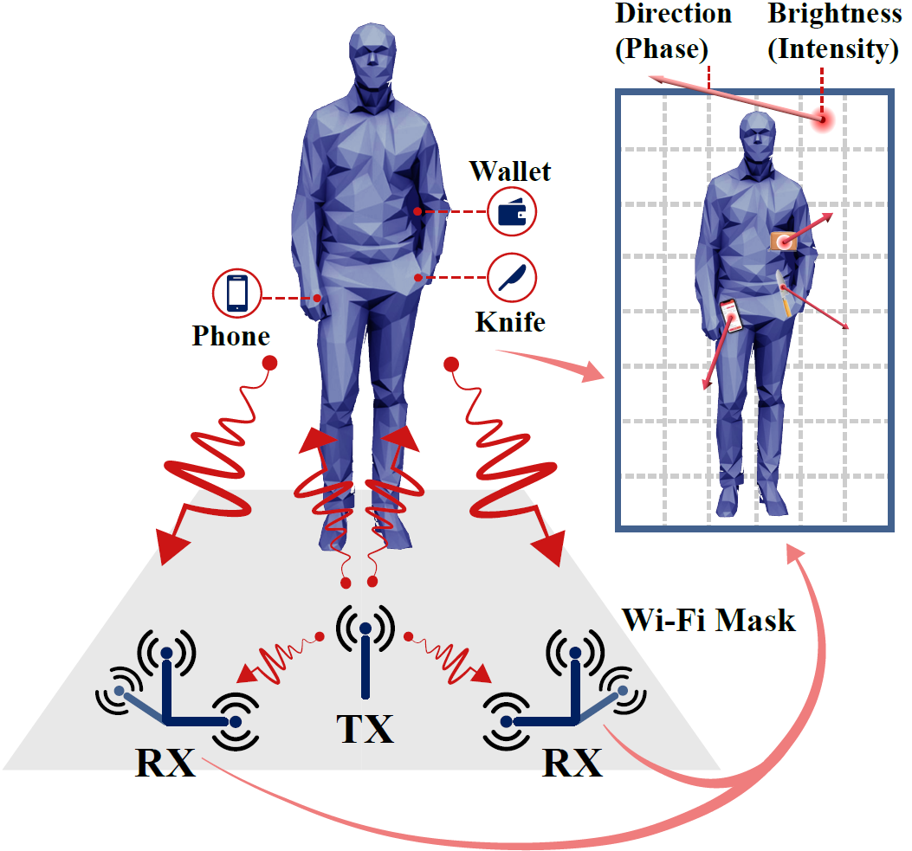
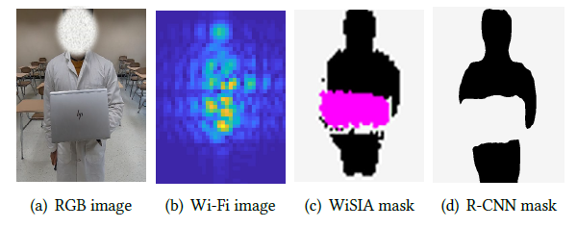
Wi-Fi See It All (WiSIA)
Our Target:
Profiling objects at the pixel scale
Recognizing multi-objects accurately
Fully using the COTS Wi-Fi devices
5
Notes:
Just imaging you perform some gestures, with the reflected WiFi signals,
our system can recognize the gesture as well as your identity simultaneously, rendering the true potential of WiFi based gesture recognition.
since many applications usually require user identities for access control and content customization, VR customization.
For example, smart home devices can only be controlled by family members but the guests or strangers. Moreover, when the identity of children or parents can be known, it can recommend different contents when they are watching TV or listening to music.

Slide 6
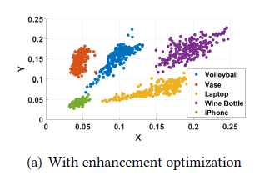
WiSIA: System Overview
Resembling light, imaging can be applicable to any kinds of electromagnetic waves.
Data Acquisition
Wave Front Construction
Pixel-wise Illumination
Segmentation Refinement
6
Notes:
Thus we propose the problem.
And the first challenges is

Slide 7
WiSIA: System Overview
Challenges:
Superposed Wi-Fi Signals at the receiver side
Coarse-grained resolution for accurate classification
Pixel-wise segmentation for profiling and recognizing
7
Notes:
Thus we propose the problem.
And the first challenges is

Slide 8
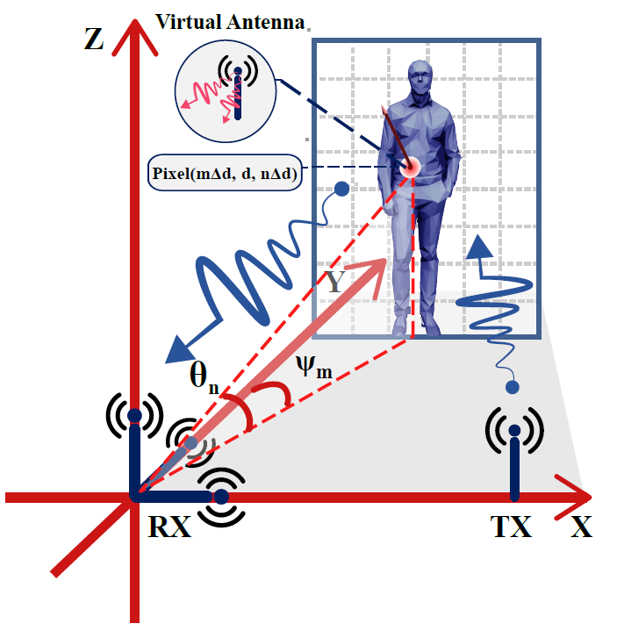
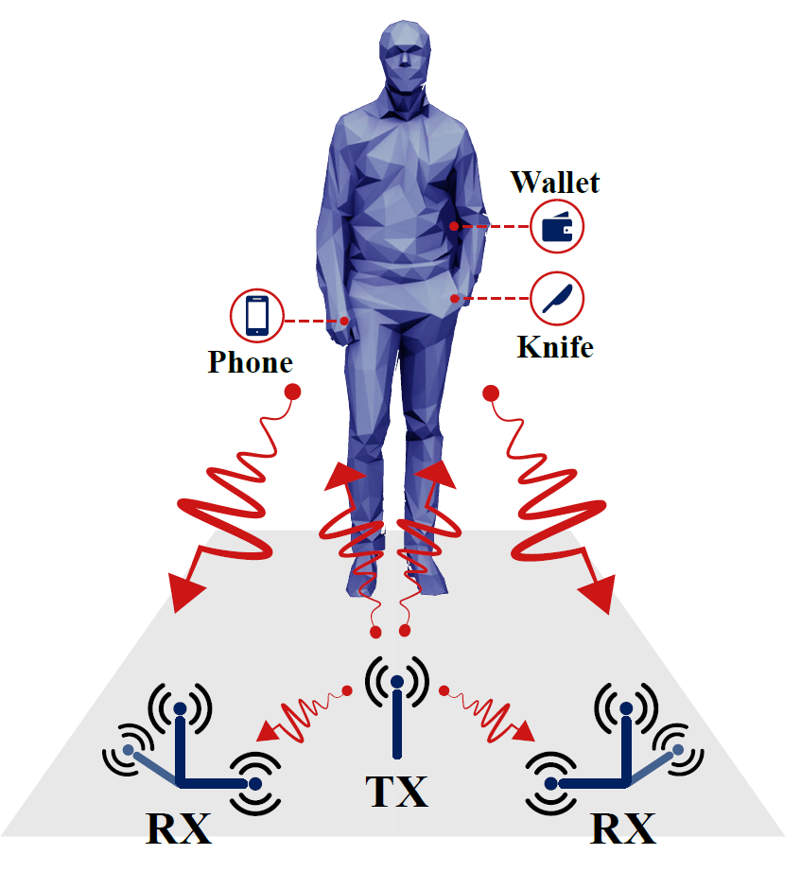
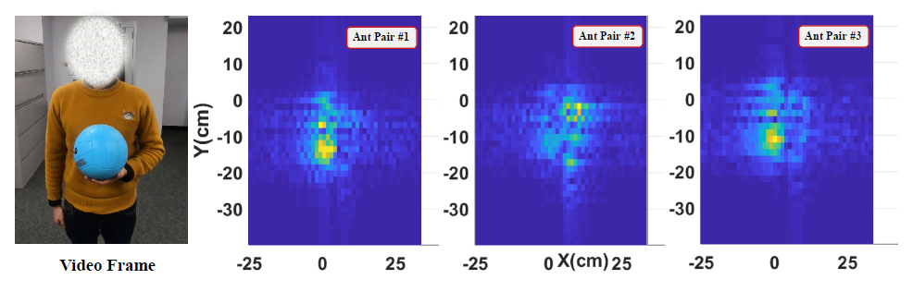
Wave Front Construction
Signal Processing：
Build the coordinates to trace signals from the imaging plane to the receiver plane
Set the pixel-wise virtual antenna for wave front recovery
Disentangle the superposed Wi-Fi signals via 2D-IFFT
Enable multiple vantage views with 6 pairs of transceivers
8
Notes:
First, we do a survey and has some theories.
To verify the feasibility of the feature design, we do some observation using the public Widar3.0 dataset.
With the spectrogram of the collected WiFi signals, as shown in the three top sub-figures, we plot three carving paths of three different users while performing the same gesture (e.g., drawing the rectangle).
Specifically, the black and red dashed lines denote the carving paths of dominant power and power bound.
The pink dashed lines which are distributed along the axis of frequency shift indicate the motion changes. With the visualization of all carving paths, we can observe both power based features and the motion change pattern varies among different users. Intuitively, different users perform the same gesture with the personalized action understanding and performing style.
Further, we collect three instances of the same gesture from all three users and superpose their carving paths for each user in the bottom three sub-figures.
We can see the power based carving paths of different instances may shift along the time axis, especially for the third user.
In contrast, for all users, their motion changes can be grouped into three clusters which correspond to the three pauses during drawing the rectangle.
In all clusters, the largest period between two motion changes across different instances is less than 70ms (the first cluster of the third user appeared at about 500ms), which demonstrates its consistency of the motion change pattern for each user across instances. The reason behind this is the inevitable noise (e.g. multi-path, body motion) has a significant influence on the power based carving paths, but motion changes are less affected.

Slide 9
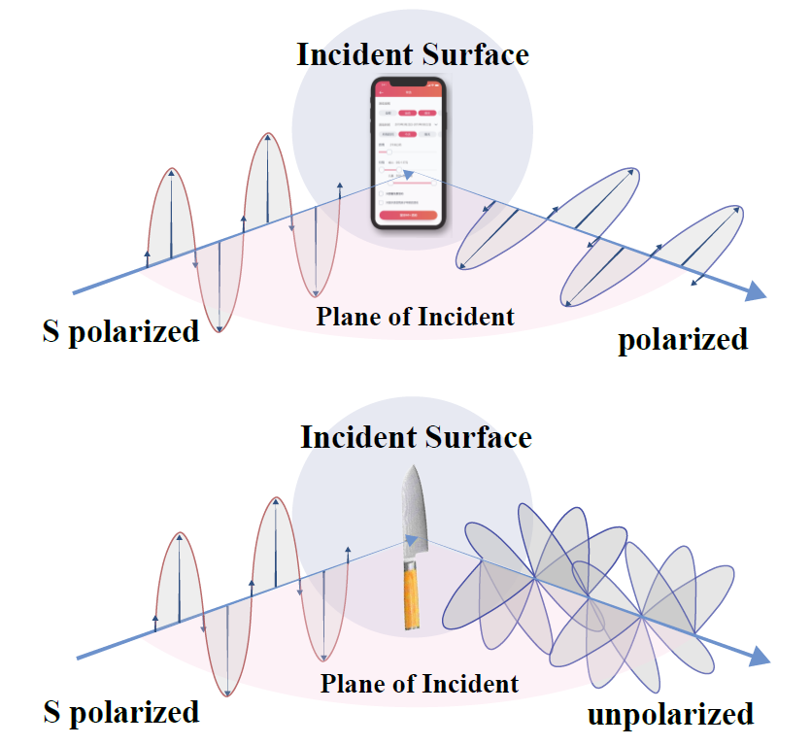
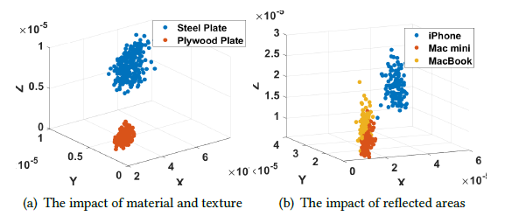
Pixel-wise Illumination
Pixel-wise classification on the wave front of the image plane.
Polarization & Magnitude
Different polarized waves can be produced while bouncing off various surfaces of materials and textures.
Magnitude of the reflected Wi-Fi signals varies as the reflected surface changes
9
Notes:
Resembling light, Wi-Fi radiations propagate as the electromagnetic wave while the electric field oscillates perpendicularly to the direction of propagation.
Different polarized waves can be produced while bouncing off various surfaces of materials and textures, such as scattering off a smooth non-metallic surface, a smooth metallic surface, and a rough surface
distinguishable 3D
point cloud in the feature space for (a). the metallic and plywood
plate of the same size. (b). daily items of the same material
and textures with various reflected areas.

Slide 10
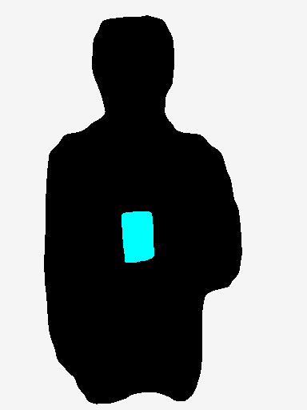
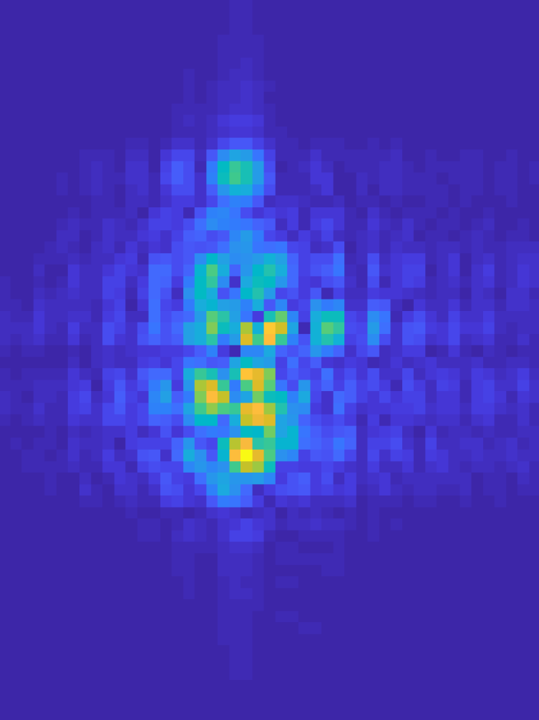
Segmentation Refinement
Translate the illuminated wave front to visual image.
Real image
L_{cGAN} (G, D_{Y}): adversarial learning to make the fake image undistinguishable with real one
L_{pixel} (G): explicitly make the fake image close to the real one
L_{cycle} (G，F): enable the bijection between wave front and real image
D_{Y}
L_{cGAN} (G, D_{Y})
Real Wave Front
G：X Y
L_{pixel} (G)
L_{cycle} (G，F)
Y: Fake image
F：Y X
Fake Wave Front
10
Notes:
Resembling light, Wi-Fi radiations propagate as the electromagnetic wave while the electric field oscillates perpendicularly to the direction of propagation.
Different polarized waves can be produced while bouncing off various surfaces of materials and textures, such as scattering off a smooth non-metallic surface, a smooth metallic surface, and a rough surface
distinguishable 3D
point cloud in the feature space for (a). the metallic and plywood
plate of the same size. (b). daily items of the same material
and textures with various reflected areas.

Slide 11
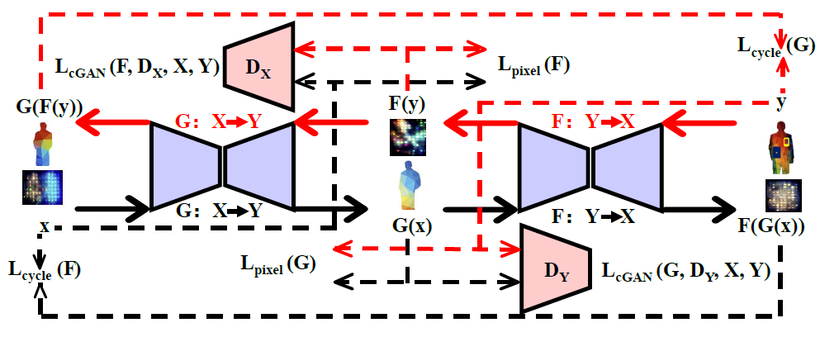
Segmentation Refinement
Translate the illuminated wave front to visual image.
11
Notes:
Resembling light, Wi-Fi radiations propagate as the electromagnetic wave while the electric field oscillates perpendicularly to the direction of propagation.
Different polarized waves can be produced while bouncing off various surfaces of materials and textures, such as scattering off a smooth non-metallic surface, a smooth metallic surface, and a rough surface
distinguishable 3D
point cloud in the feature space for (a). the metallic and plywood
plate of the same size. (b). daily items of the same material
and textures with various reflected areas.

Slide 12
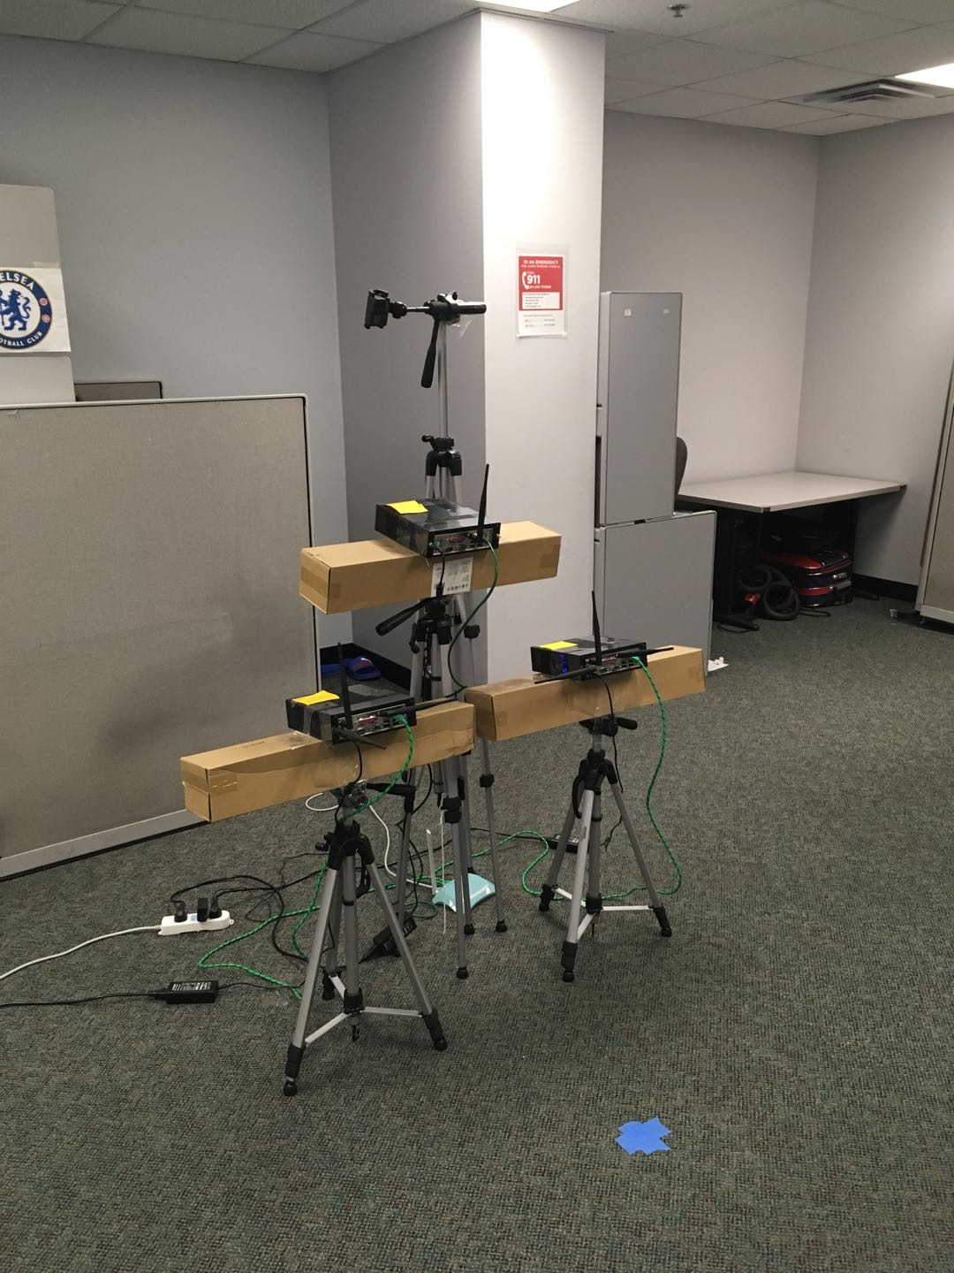
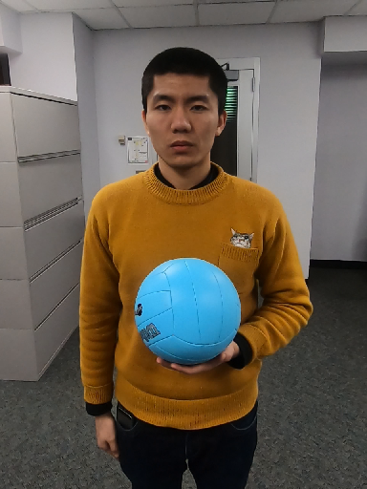
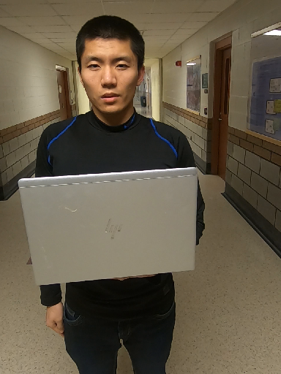
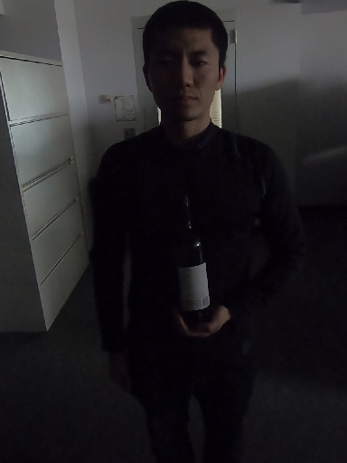
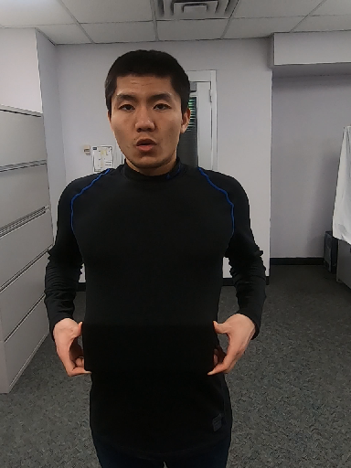
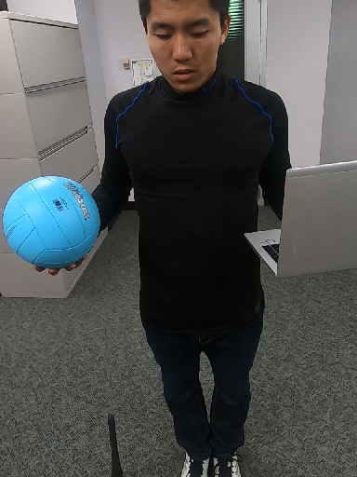
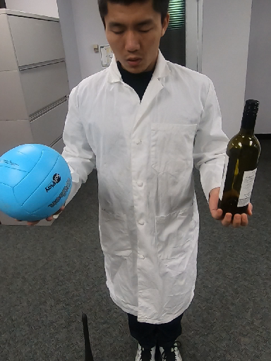
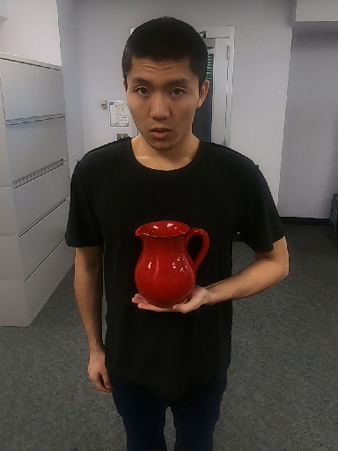
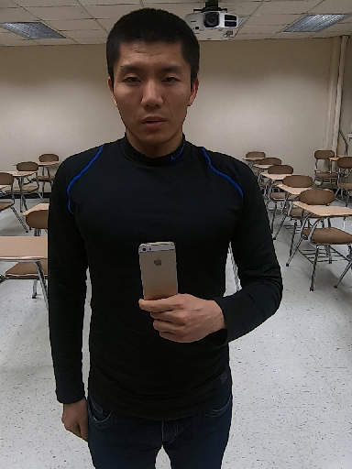
Implementation
Hardware：2 pairs of transceivers for Wi-Fi and GoPro for images
Ground truth: We apply the Mask R-CNN to acquire the masks and further improve them by labelling manually.
Office
Transmitter Antenna
GoPro
Camera
Receiver Antennas
Setups | Notations
Objects | 5 objects for cross-domain testing in environments, clothes, etc.
Location | Object in various positions on body and distance to transceivers.
Specials | Multi-objects, dark light, occlusions, etc.
Receiver Antennas
Anchor Marker
12
Notes:
To validate the effectiveness of our system, we do the evaluation on the public dateset published by widar3.0.

Slide 13
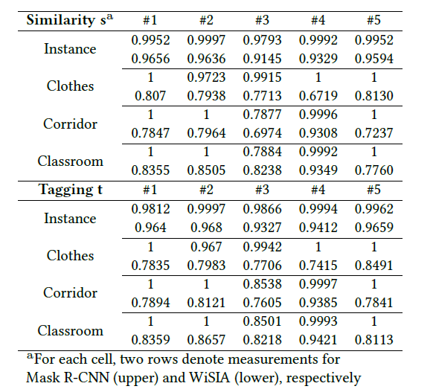
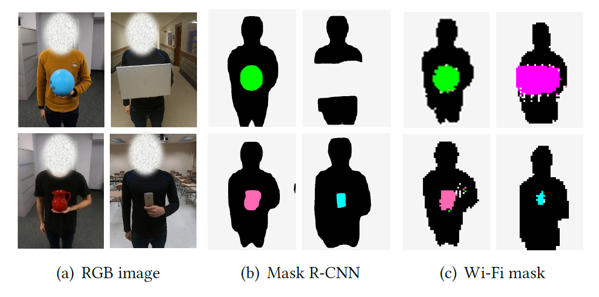
Evaluation： Objects
Metric:
Szymkiewicz-Simpson similarity S measures the overlapping of profiling
Tagging accuracy T evaluates the pixel-wise classification between the
13

Slide 14
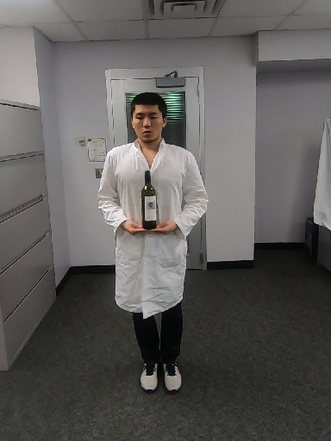
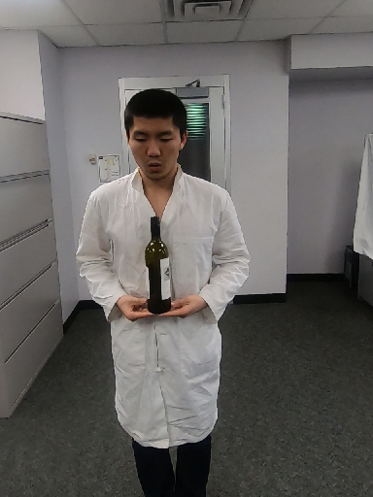
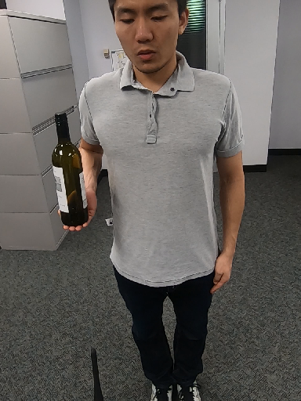
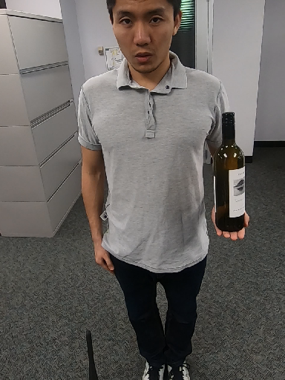
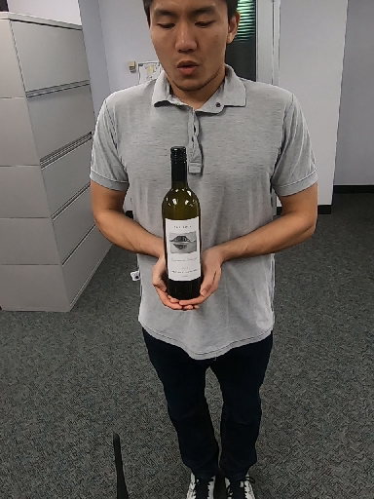
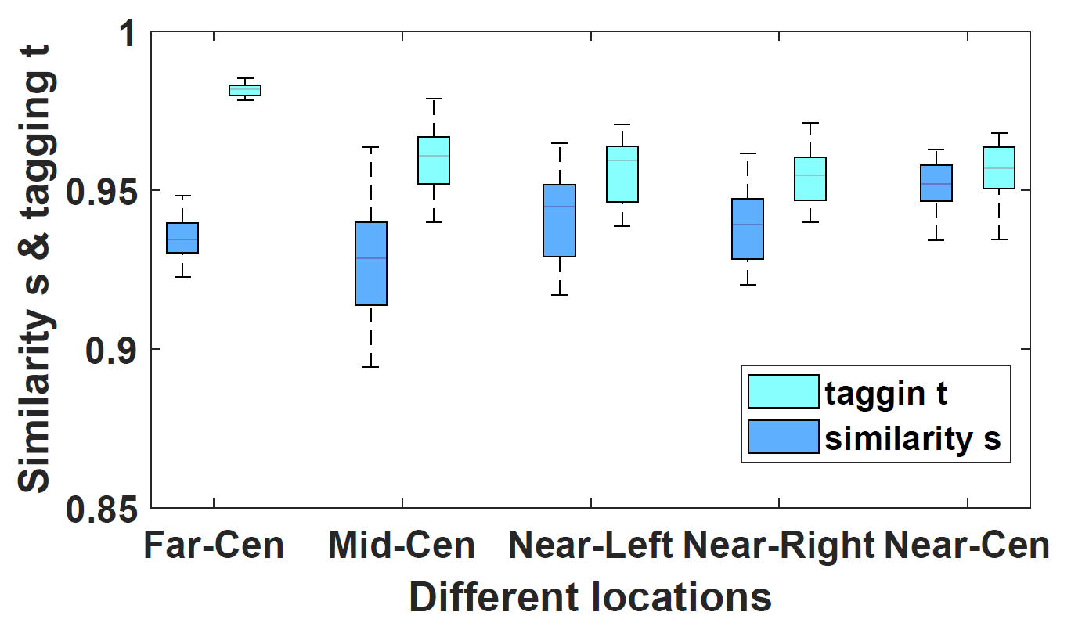
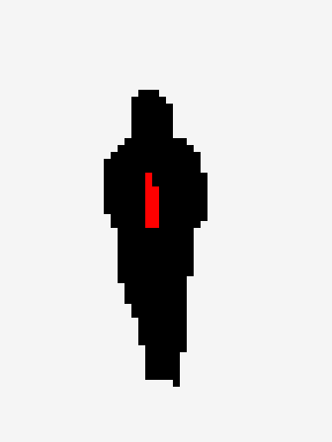
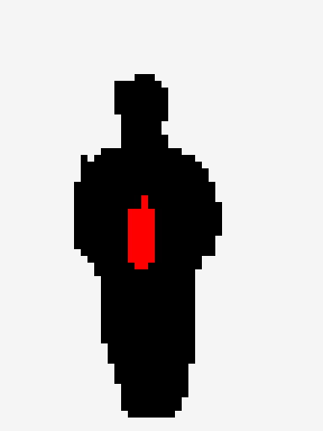
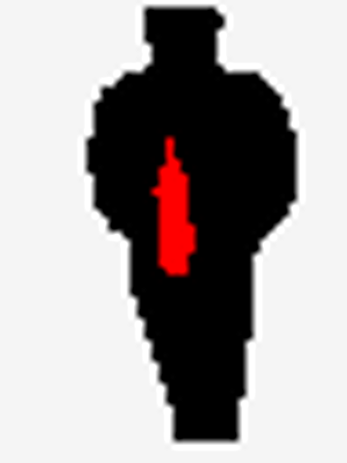
Evaluation：Locations
Far-Center
Middle-Center
Near-Left
Near-Right
Near-Center
WiSIA can deal with the location dynamics within the maximum effective distance as 2.1m
14

Slide 15
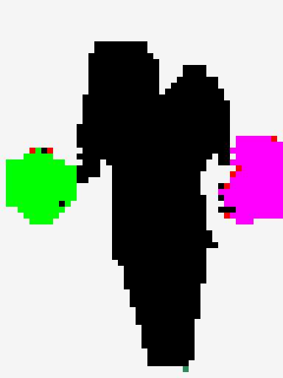
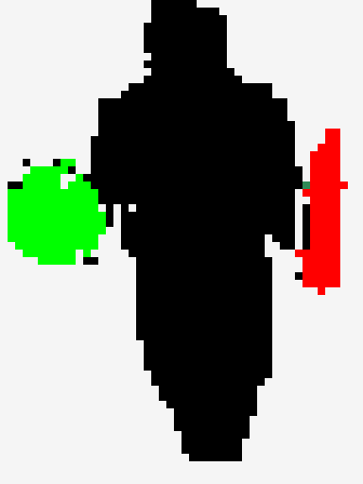
Evaluation: Specials
Video Frame
Mask R-CNN
Our System
Video Frame
Our System
WiSIA demonstrates the consistent performance in dark light and occlusions, making it complementary to existing vision-based systems.
15
Notes:
using the same dataset
The performance is consistent with the observation on the power based feature and the motion change pattern
The cross-domain ability of designed feature.

Slide 16
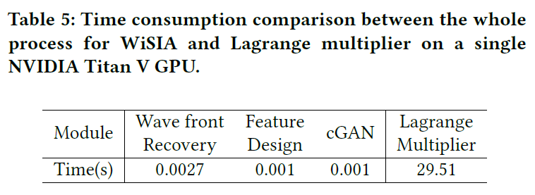
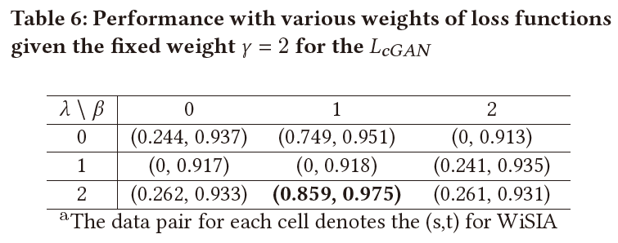
Parameter Study
Running Time Analysis:
Ablation Study:
Real-time Operation
Enhance the illuminated wave front at pixel scale
Multiple loss functions makes it close to the vision-based system
16
Notes:
WiHF demonstrates accessible performance when the number of users or gestures is up to 9

Slide 17
Discussions & Conclusions
Surface properties and effective range
Multiple physical features and fine-grained wireless signal can be incorporated for real life deployment
Deployment cost
The relative motion is required between the imaging targets and the transceivers without the static massive antennas
Continuous movement and generalization
Currently, we only evaluate our system for targets on the spot and have to re-train our cGAN model for different setups.
WiSIA is the first versatile Wi-Fi imaging system to simultaneously detect objects and humans, segment their boundaries, and identify them within the image plane.
We expect to explore more challenging scenarios in imaging via wireless signals, such as the 3D scenarios, holography, and medical micro-scale imaging.
17
Notes:
To design WiSIA,We have developed novel techniques related to
ray tracing, wave polarization and deep learning to enable realtime
Wi-Fi imaging, multi-object detection and identification,
and fine-grained segmentation enhancement.
We implemented a prototype of WiSIA using COTS Wi-Fi devices,
and evaluated its performance in various scenarios. The experimental
results demonstrate the efficacy of WiSIA in comparison
with vision-based approaches

Slide 18
Thanks!
Q&A
Chenning Li
chenningli2019@gmail.com
“We can only see a short distance ahead, but we can see plenty there that needs to be done.”——Alan M. Turing
18
Notes:
WiHF suffers severely for some orientations in the cross-domain testing due to the shadow effect :
The complexity and duration of for motion change pattern to capture the personalized performing style (Drawing the rectangle vs. Clapping).

