Slide 1
CurvingLoRa to Boost LoRa Network Throughput via Concurrent Transmission
Chenning Li¹, Xiuzhen Guo², Longfei Shuangguan³,
Zhichao Cao¹, Kyle Jamieson⁴
¹ Michigan State University ² Tsinghua University
³ University of Pittsburgh & Microsoft ⁴ Princeton University
April 5 @ USENIX NSDI’22
1
Notes:
My name is Chenning Li, I am a graduate student at Michigan State University.
The paper I will be presenting today is titled “CurvingLoRa”, a new physical layer design for LoRa networking.

Slide 2
Smart World - 5G and LoRaWAN
2
Credits to LoRa Alliance https://lora-alliance.org/lorawan-coverage/
Notes:
While 5G will be useful in most bandwidth-intensive IoT deployments, it cannot be a good choice for those large-scale IoT applications,
Such as in the agriculture, oil and gas, utilities and transportation industries, which only require only small data amounts communicated at a low power manner. Usually, it is the LoRaWAN network.

Slide 3
LoRaWAN Network Operates globally
>3.2 million gateways
240 million end nodes
>50% of all non-cellular Low Power Wide Area connections will feature LoRa by 2026
(ABI research)
MAC Layer with a Pure ALOHA System makes the decoding suffer from concurrent transmissions
3
Credits to LoRa Alliance https://lora-alliance.org/lorawan-coverage/, https://www.semtech.com/lora
Notes:
Driven by the demands, LoRaWAN network grows and operators globally,
with millions of LoRa devices and it could dominate the non-cellular low power wide area connections by 2026.
However, its simple MAC Layer with a Pure ALOHA System makes the decoding suffer from concurrent transmissions.
The end nodes simply transmit whenever they need to. As a result, massive collisions results in decoding failure and throughput degradation.

Slide 4
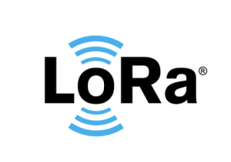
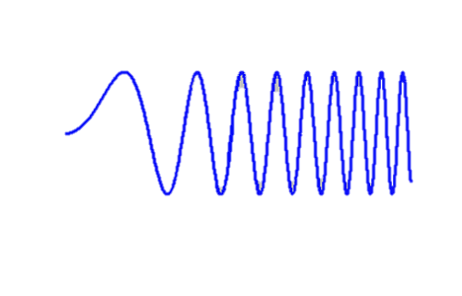
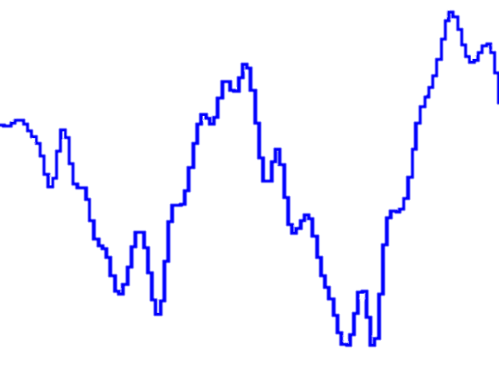
Background: LoRa’s PHY Layer
PHY Layer: Chirp Spread Spectrum Modulation
Bandwidth (BW): Fixed-bandwidth Channel, 125, 250, 500 KHz.
Spreading Factor (SF): the amount of spreading code applied to the original data signal, from SF7 to SF12.
IoT
Sensors
Gateway
$$f$$
$$+\frac{BW}{2}$$
$$f$$
$$+\frac{BW}{2}$$
$$f$$
$$+\frac{BW}{2}$$
$$Amplitude$$
Spectrogram of a chirp symbol
$$t$$
$$t$$
$$t$$
$$f$$
$$−\frac{BW}{2}$$
$$−\frac{BW}{2}$$
$$−\frac{BW}{2}$$
$$0$$
$$2^{SF}−1$$
$$FFT bin$$
Dechirp
4
Notes:
Before I introduce our work, please allow me to introduce LoRa’s background at the Physical layer for modulation, that is the chirp spread spectrum modulation.
Here, the chirp indicates the signal whose frequency increases linearly over time, which can be observed by the spectrogram of a chirp symbol.
It has two configurations, the bandwidth and the spreading factor which determines the amount of spreading code applied to the data signal.
From the transmitter to the receiver, we adopt the Dechirp for decoding.
Upon receiving the chirp signals,
we can multiply the received chirp symbol with the base down-chirp (shown as the green line).
In this way, we can concentrate the spectral energy into a single frequency bin.
By adopting FFT on the dechirped signal, we can decode the signal by detecting the energy peak on the spectrum.

Slide 5
Background: LoRa’s PHY Layer
PHY Layer: Chirp Spread Spectrum Modulation
$$+\frac{BW}{2}$$
$$f$$
$$+\frac{BW}{2}$$
$$f$$
$$Amplitude$$
IoT
Sensors
No Collision
Gateway
$$t$$
$$t$$
$$−\frac{BW}{2}$$
$$f_{0}$$
$$−\frac{BW}{2}$$
$$f_{0}$$
$$b_{0}$$
$$2^{SF}−1$$
$$0$$
$$FFT bin$$
$$+\frac{BW}{2}$$
$$f$$
$$+\frac{BW}{2}$$
$$f$$
$$Amplitude$$
In Collisions
$$t$$
$$t$$
$$−\frac{BW}{2}$$
$$−\frac{BW}{2}$$
$$b_{0}$$
$$2^{SF}−1$$
$$0$$
$$FFT bin$$
5
Notes:
Shown in this figure, in case of no collisions, the sensor nodes can encode data bits into the shifted initial frequency, at the gateway side,
it can focus the chirp energy into the shifted frequency on the spectrum and decode the data bits by detecting the energy peak,
say b_0, which corresponds to the encoded f_0 at the transmitter side.
However, decoding ambiguity occurs in collisions.
Since the targeting chirp can be overwhelmed by the interfered chirp signals, shown as the blue line.

Slide 6
Background: LoRa’s PHY Layer
Concurrency
$$f$$
$$+\frac{BW}{2}$$
…
$$t$$
$$−\frac{BW}{2}$$
$$Amplitude$$
$$Symbol 1$$
$$Symbol 2$$
$$Symbol 3$$
$$Symbol 4$$
…
SIR
Signal-Interference Ratio
$$Amplitude$$
$$Symbol 1$$
$$Symbol 2$$
$$Symbol 3$$
$$Symbol 4$$
$$f$$
…
SNR
Signal-Noise Ratio
$$Symbol 1$$
$$Symbol 2$$
$$Symbol 3$$
$$Symbol 4$$
$$f$$
6
Notes:
As a result, we could inevitably have the collisions with two concurrent LoRa packets,
and the decoding failure results in the throughput degradation. Because we cannot detect the targeting blue energy peak reliably.
It suffers more from the decoding ambiguity with massive concurrencies.
And the low SNR and SIR conditions can make it harder for the Dechirp processing.

Slide 7
Existing Works
Time-domain feature design at PHY Layer
Frequency-domain feature design at PHY Layer
Multi-channel Access at MAC Layer
NScale
MobiSys ’20
Choir
SIGCOMM’17
LMAC
MobiCom ’20
CIC
SIGCOMM ’21
mLoRa
ICNP ’19
CoLoRa
INFOCOM ’20
SCLoRa
ICNP ’20
DeepSense
arXiv’19
FTrack
SenSys ’19
OCT
INFOCOM ’20
FlipLoRa
SECON ’20
Pyramid
INFOCOM ’21
AlignTrack
ICNP ’21
p-CARMA
EWSN ’20
Suffers under Low SNR
Limited by the SIR levels
Extra Complexity and Cost
7
Notes:
LoRa’s collision issues have been a hot research topic, which convers the physical and mac layer feature design.
However, all suffer from different environmental factors.
For example, in the time-domain at the PHY layer, the adopted successive interference cancellation suffers under low SNRs while the Multi-channel Access at MAC-Layer can introduce extra complexity and cost for the simple LoRa networking stack.

Slide 8
CurvingLoRa for Resolving Collisions
Replace the Linear Chirp with Its Non-linear Counterparts
$$f$$
$$Amplitude$$
$$f$$
$$Amplitude$$
$$+\frac{BW}{2}$$
$$Aligned Symbol$$
$$+\frac{BW}{2}$$
$$Aligned Symbol$$
$$t$$
$$t$$
$$−\frac{BW}{2}$$
$$0$$
$$2^{SF}−1$$
$$−\frac{BW}{2}$$
$$0$$
$$2^{SF}−1$$
$$FFT bin$$
$$FFT bin$$
$$f$$
$$Amplitude$$
$$f$$
$$Amplitude$$
$$+\frac{BW}{2}$$
$$Misaligned Symbol$$
$$+\frac{BW}{2}$$
$$Misaligned Symbol$$
Scattering Effect
$$t$$
$$t$$
$$−\frac{BW}{2}$$
$$2^{SF}−1$$
$$−\frac{BW}{2}$$
$$0$$
$$2^{SF}−1$$
$$0$$
$$FFT bin$$
$$FFT bin$$
8
Notes:
We start thinking about the root cause for the interference of those concurrent LoRa chirps, with the chirp symbol shown here.
When we align the operation window with the chirp symbol,
it can form an energy peak on the spectrum.
And for those interfered chirp symbols, which are always misaligned with our operation window,
it can still form an energy peak on the spectrum. At a high level, the green down-chirp signal is always up-down symmetrical with the chirp symbol for the overlapping part, resulting in an energy peak no matter it is aligned with the operation window or not.
But how about the non-linear chirps?
When it is aligned, it can form an energy peak as well.
However, when it is misaligned, the down-chirp signal is not up-down symmetrical with the chirp symbol for the overlapping part and cannot form an energy peak anymore.

Slide 9
CurvingLoRa for Resolving Collisions
Scattering Effect of Non-linear chirps
$$f$$
$$Amplitude$$
$$f$$
$$Amplitude$$
$$+\frac{BW}{2}$$
$$Symbol B$$
$$+\frac{BW}{2}$$
$$Aligned Symbol$$
$$A aligned$$
$$t$$
$$B aligned$$
$$t$$
$$−\frac{BW}{2}$$
$$0$$
$$2^{SF}−1$$
$$−\frac{BW}{2}$$
$$0$$
$$2^{SF}−1$$
$$Symbol A$$
$$FFT bin$$
$$FFT bin$$
9
Notes:
With this observation, when symbol A and B overlap with each other, we can decode them by aligning with them alternatively.
In this way, we could achieve a high throughput with massive concurrent transmissions.

Slide 10
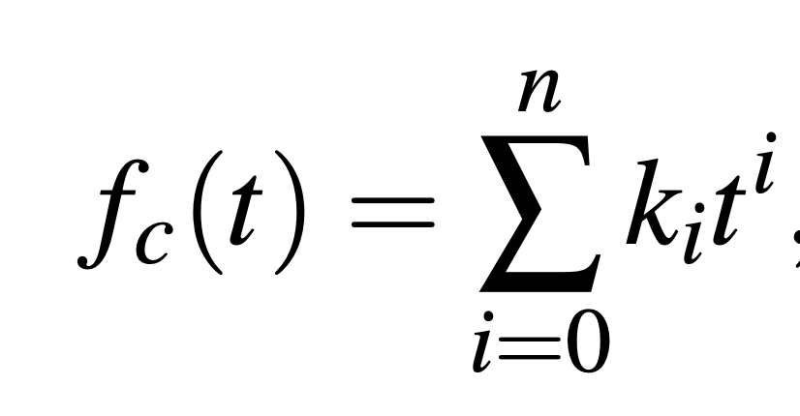
1. Formulation for Chirp-based Modulation
Given the BW and SF for Modulation:
$$k_{0}=−\frac{BW}{2}$$
$$k_{1}=\frac{{BW}^{2}}{2^{SF}}$$
$$k_{0}=−\frac{BW}{2}$$
$$k_{2}=\frac{{BW}^{3}}{2^{2SF}}$$
$$k_{0}=−\frac{BW}{2}$$
$k_{1}=\frac{{BW}^{2}}{2^{SF−1}};k_{2}=$- $\frac{{BW}^{3}}{2^{2SF}}$
$$f$$
$$f$$
$$f$$
$$+\frac{BW}{2}$$
$$+\frac{BW}{2}$$
$$+\frac{BW}{2}$$
$$t$$
$$t$$
$$t$$
$$−\frac{BW}{2}$$
$$−\frac{BW}{2}$$
$$−\frac{BW}{2}$$
10
Notes:
for our system design, we first formulate the generation of chirp.
Given the configured bandwidth and spreading factor, we represent the chirp signal in a Polynomial form.
In this way, we can generate all kinds of chirps, like the linear one, quadratic one, or even the sine function.

Slide 11
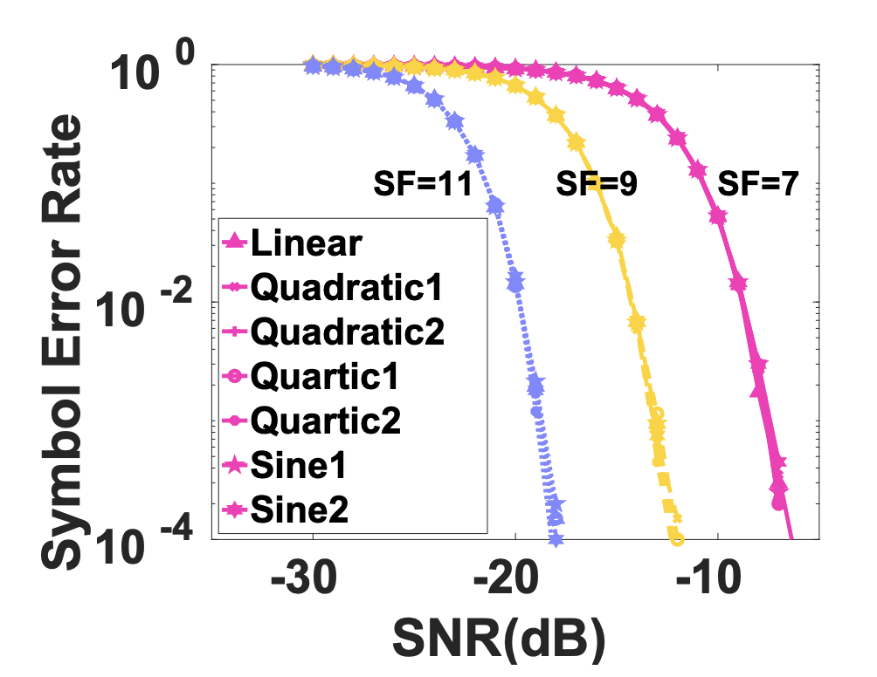
2. CurvingLoRa’s Noise Resilience
Chirp Spread Spectrum Modulation Suppress Noises by Focusing the Spectral Energy into the Encoded Frequency Bin
$$f$$
$$+\frac{BW}{2}$$
$$Aligned Symbol$$
$$t$$
$$f$$
$$−\frac{BW}{2}$$
$$+\frac{BW}{2}$$
$$Amplitude$$
$$t$$
$$f$$
$$−\frac{BW}{2}$$
$$0$$
$$2^{SF}−1$$
$$+\frac{BW}{2}$$
$$Aligned Symbol$$
$$FFT bin$$
$$t$$
$$−\frac{BW}{2}$$
11
Notes:
Given our non-linear chirp design we first prove that non-linear chirps have the same noise resilience with the linear one for the low-snr communication.
Since we know the chirp spread spectrum suppress the noise by focusing the spectral energy of the chirp symbol, which is only impacted by chirp length and transmission power, not its shape.
We further do the preliminary to evaluate the symbol error rate of various chirps under a range of SNR conditions. As you can ,the SER-SNR lines overlap with each other with the same chirp length and transmission power.

Slide 12
3. CurvingLoRa Under Collisions
CurvingLoRa’s Scattering Effect for Misaligned Chirp Symbols
$$f$$
1. Modulate Data for Aligned Chirp Symbol
$$Amplitude$$
$$+\frac{BW}{2}$$
$$t$$
$$2^{SF}−1$$
2. Collided Chirps with a Time Offset t_{gap}
$$0$$
$$−\frac{BW}{2}$$
$$FFT bin$$
$$t_{gap}$$
For Linear Chirps fc(t)=k₁t+k₀
F(t) = f₀+k₁(t+$t_{gap}$)+k₀ - (k₁t+k₀) = f₀ +k₁$t_{gap}$
$$f$$
$$Amplitude$$
$$+\frac{BW}{2}$$
For Non-linear Chirps e.g., f_{c}(t)=k₂t²+k₀
F(t) = f₀+k₂(t+$t_{gap}$)²+k₀ - (k₂t²+k₀) = f₀+k₂ $t_{gap}^{2}$+2k₂$t_{gap}$×t
$$t$$
$$2^{SF}−1$$
$$0$$
$$−\frac{BW}{2}$$
$$FFT bin$$
$$t_{gap}$$
12
Notes:
We then explain the difference between the linear chirp and non-linear chirps, especially the scattering effect of non-linear chirps for those misaligned chirp symbols.
As mentioned before, when aligning the target chirp symbol with the operation window, we can observe the energy peak on the spectrum for both,
no matter it’s linear or non-linear one.
For misaligned chirp with a time gap, things become different.
We have to consider the impact of the t_gap on the Dechirp processing.
For the linear chirp, since the resulting frequency is time-invariant.
As a result, the spectral energy can always be concentrated into a single bin, and the energy peak for the target chirp has to be higher than the other two peaks for correct decoding.
In contrast, for the non-linear one, its resulting frequency is time-variant, which means that its energy distribution varies as the time, resulting in an energy plateau over the spectrum.
And we can decode successfully only if p_1 is larger than the those scattered energy plateau.

Slide 13
3. CurvingLoRa Under Collisions
Various SIRs, $t_{gap}$, and SFs
13
Notes:
In this page, we show the impact of various SIRs, t_gaps and spreading factors on the scattering effect of non-linear chirp modulation. We use the quadratic1 as the example.
First, we show the spectrogram of the aligned target chirp symbol, overlapping with a partial interfered chirp symbol.
By adjusting the overlapping ratio with the parameter t_gap, we can see that, with a smaller t_gap, we have move overlapping between the interfered chirp and the target chirp, so the height of the energy peak for the interfered chirp get closer to the target one’s. However, the increment for non-linear chirps can be ignored.
We further adjust the power ratio SIR between them, with a lower SIR, the target chirp gets weaker for linear chirp.
In contrast, the energy peak of the target chirp symbol can still be detected with the scattered spectral energy from the interfered chirp.

Slide 14
4. CurvingLoRa’s Coding Space
CurvingLoRa Extends the Orthogonal Coding Dimension
$$f$$
$$Amplitude$$
$$+\frac{BW}{2}$$
$$t$$
$$−\frac{BW}{2}$$
$$0$$
$$2^{SF}−1$$
$$FFT bin$$
By assigning the data bits into the shape of chirp symbols
14
Notes:
We have discussed the collisions for a single-type chirp with various overlapping, we also observe the orthogonality among different kinds of chirp shapes, enabling an extra coding dimension.
Two types of chirp symbols deliver a good orthogonality and can be decoded even fully overlapping with each other, like the non-linear meets another non-linear, or non-linear meets the linear one.
As a result, we can have various types of chirp signals represent the data information to further increase the throughput.

Slide 15
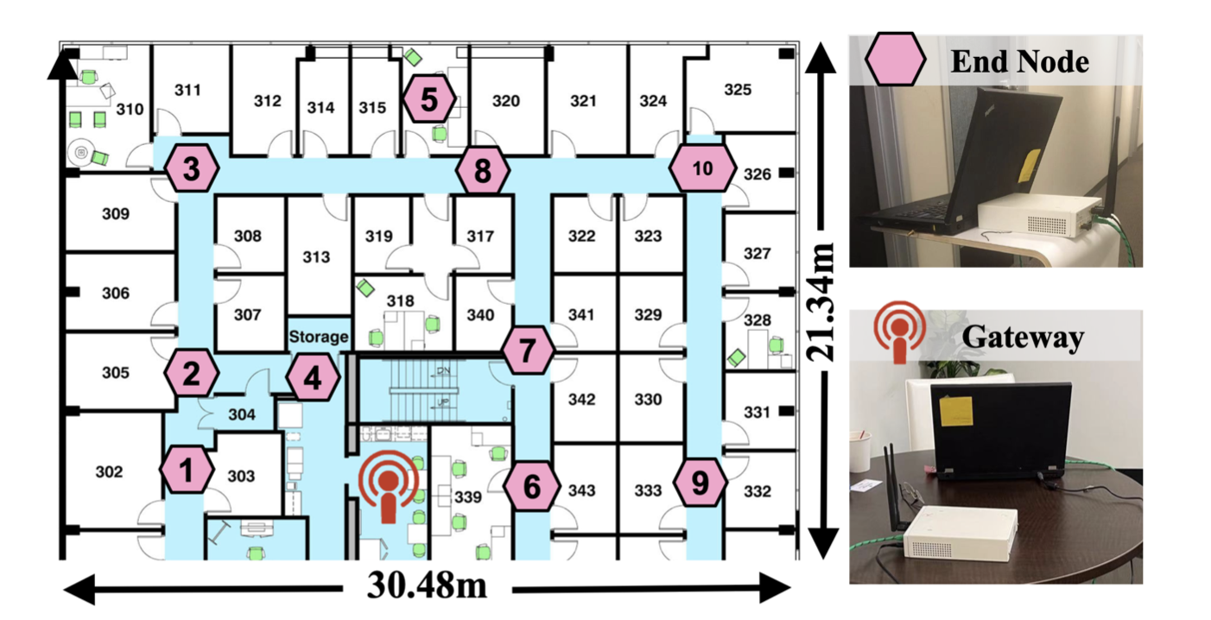
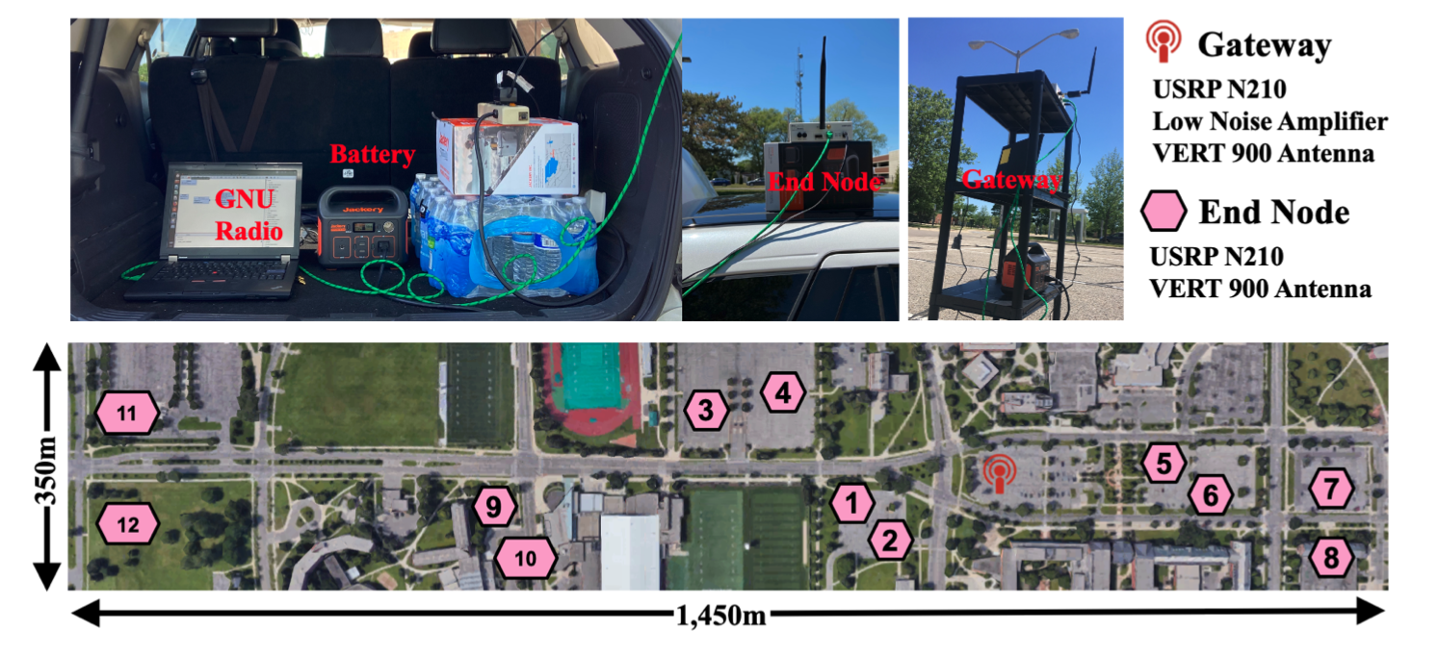
Implementation
Metric:
Symbol Error Rate (SER)
Packet Delivery Rate (PDR)
Throughput (Symbols/Second)
Baseline:
Standard LoRaWAN
mLoRa ICNP ’19 at the time domain of PHY
NScale MobiSys ’20 at the frequency domain of PHY
Non-linear Chirp Candidate:
What We Care:
Noise Resilience in SNRs
Fluctuated SIRs
Performance at the Campus Scale
15
Notes:
From this page, we introduce the implementation and evaluation for our paper.
We compare the ser, the pdr and throughput of CurvingLoRa with the three baseline.
For the non-linear candidates, we focus on four types of non-linear chirps to evaluate CurvingLoRa’s performance.
Note that, in this paper, we only care about the collision of a single-type chirp and evaluate the Noise Resilience, Symbol Offset, Near-far Issues with Fluctuated SIRs, Performance at the Campus Scale
Our evaluation includes the indoor and outdoor scenarios. More details can be found in our paper.

Slide 16
Evaluation： Symbol Level Performance
Same Noise Tolerance with the Linear Chirp
16

Slide 17
Evaluation： Symbol Level Performance
To maintain 1% SER:
-10dB
-5dB
-5dB
-15dB
17

Slide 18
Evaluation： Outdoor Performance
8×
3×
18
Notes:
Here we show the performance for the outdoor scenario.
First, due to the collision issues, the standard lorawan keeps an almost consistent throughput even with more concurrencies.
In contrast, the state of the arts can increase the throughput by up to three times based on the linear chirp feature design.
However, base on our non-linear chirp modulation, it can reach up to 8 times over the standard lorawan. Note that curvinglora is orthogonal to all state-of-the-arts by incorporating those feature design in non-linear chirp modulation.

Slide 19
Conclusions & Future Work
CurvingLoRa Boosts Network Throughput via Concurrent Transmission
Future Work
Non-linear Chirp Selection
CurvingLoRa at Higher Layers of LoRa Networking
Extend the Orthogonal Coding Space
The datasets and source codes are available at https://github.com/liecn/CurvingLoRa_NSDI22
Credits to LoRa Alliance https://lora-alliance.org/lorawan-coverage/

Slide 20
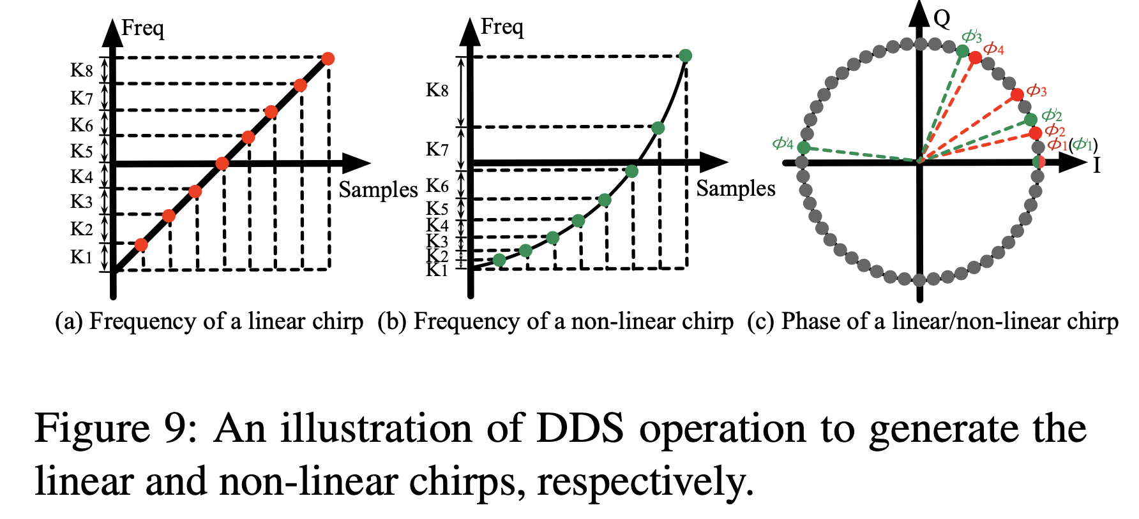
Chirp Generation
Comparable Power Consumption using the Direct Digital Synthesis (DDS) for Chirp Signal Generation
20
Notes:
Given our non-linear chirp design we first prove that non-linear chirps have the same noise resilience with the linear one for the low-snr communication.
Since we know the chirp spread spectrum suppress the noise by focusing the spectral energy of the chirp symbol, which is only impacted by chirp length and transmission power, not its shape.
We further do the preliminary to evaluate the symbol error rate of various chirps under a range of SNR conditions. As you can ,the SER-SNR lines overlap with each other with the same chirp length and transmission power.

Slide 21
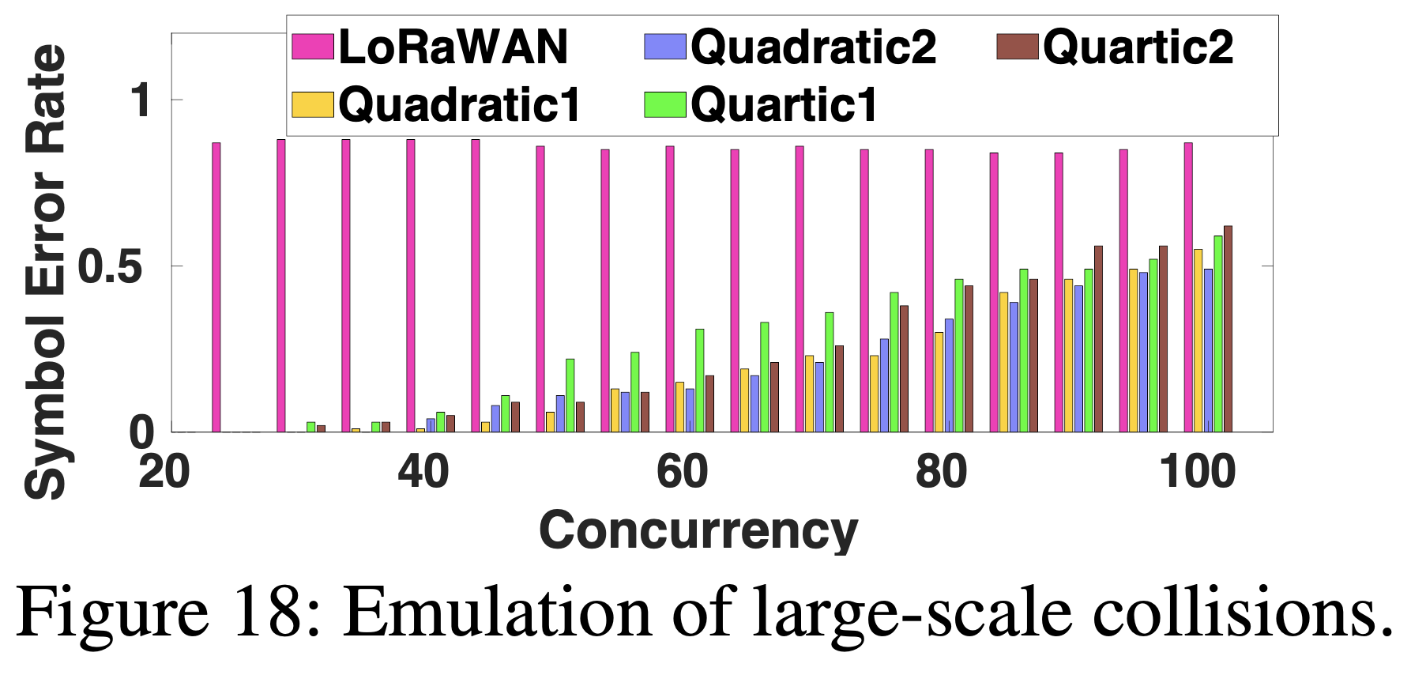
Evaluation： Emulation
21
Notes:
Here we show the performance for the outdoor scenario.
First, due to the collision issues, the standard lorawan keeps an almost consistent throughput even with more concurrencies.
In contrast, the state of the arts can increase the throughput by up to three times based on the linear chirp feature design.
However, base on our non-linear chirp modulation, it can reach up to 8 times over the standard lorawan. Note that curvinglora is orthogonal to all state-of-the-arts by incorporating those feature design in non-linear chirp modulation.

